Slide 1
Welcome New Aggies!
Online International and National Academic Advising
Fall 2018
Yasmine V. Jefferson,
Academic Advisor
College of Biological Sciences
University of California, Davis

Slide 2
This presentation will cover:
What is Academic Advising?
How do I register?
How do I choose my courses?
Answering Your Questions

Slide 3
Welcome to UC Davis!

Slide 4
Biology Academic Success Center (BASC)
1023 Sciences Lab Building Front Desk: 530-752-0410 Email: cbsundergrads@ucdavis.edu
Appointments and Resources: basc.ucdavis.edu
Services:
Academic planning & course selection
Strategize with you to meet graduation requirements (Major, GEs, College English Composition Requirement, etc.)
Can help with academic difficulties
Leave of absence(s)
Petitions & Exceptions
Referrals to other campus resources

Slide 5
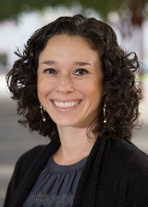
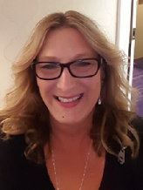
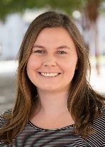
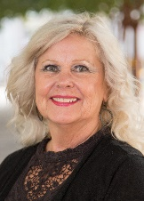
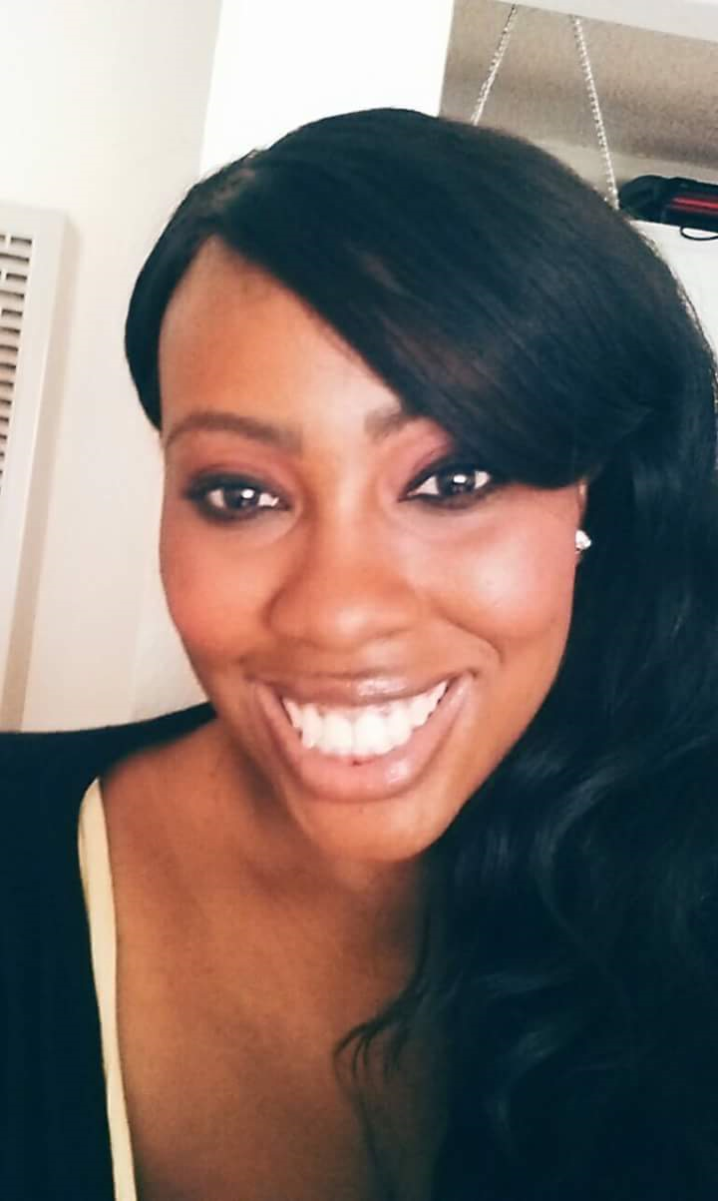
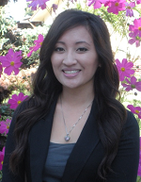
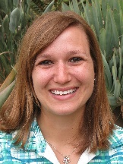
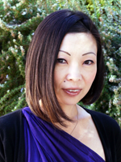
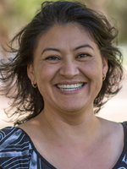
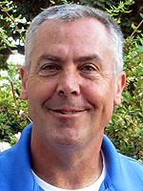
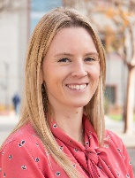
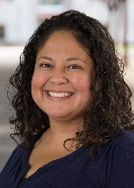
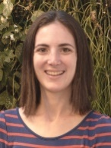
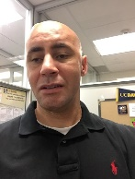
Your BASC Advisors
Julie Burgal
Tori Hollowell
Abby
Mansour
Julie Evans
Yasmine V. Jefferson
Sophy
Ney
Joyce Fernandez
Maria
Saldana-
Seibert
Millie Ling-Tsai
Tom Hall
Mackenzie Lucky
Elia
Salgado
Jennifer Halpert
William Madden
Terri
Zamora

Slide 6
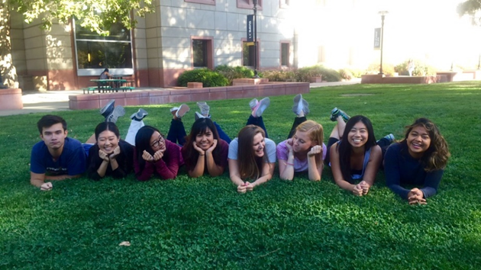
Additional BASC Advising Services
Faculty Advisors: Associated with each major and can help you:
Research options
Assist with graduate school plans and career opportunities
Peer Advisors: Students in the College of Biological Sciences (CBS)can help you with:
Courses and scheduling
Filling out petitions
General Education requirements
On-campus involvement and
resources

Slide 7
How to Prepare for Registration
5 Steps to Success
Review Placement Exam Scores: English, Math, and/or Chemistry
1
Confirm AP/IB/A-Level Scores (if any)
2
Enter information into 1st Quarter Course Recommendation Tool
3
Save preferred schedule and confirm Pass Time in Schedule Builder
4
Register for courses during Pass 1
5

Slide 8
Placement Exams and Scores
Entry Level Writing Requirement
Math
Chemistry
Satisfied with one of the following:
SAT/ACT/AP Test Scores
English Language Placement Exam (ELPE)
Satisfied with one of the following:
AP/IB/A-Levels
Placement Exam
Satisfied with one of the following:
SAT/ACT/AP Test Scores
Chemistry Placement Exam
OR Preparatory Options (ALEKS or course WLD 41C)

Slide 9
Pass Times – Fall 2018
VISIT: registrar.ucdavis.edu
Pass 1
Register for Recommended Courses
Pass 2
Register or Waitlist for Courses that were not available during Pass 1
Open Registration
Any necessary changes to your schedule can be made at this time
Registration Freeze
Advisors will be reviewing your schedules and may be suggesting changes
Schedule Adjustment
Last chance to make schedule adjustments

Slide 10
What is a “good” schedule for fall quarter?
Balanced schedule with 13-15 units
How do I calculate total units?
Workload units count. Ex: WLD 57 or WLD 41C
What do I do if a class is full?
Waitlist during Pass 2
Select alternative classes
Avoid Time Conflicts
Lower Division 1-99, Upper Division 100-199
You should only be in lower division classes this quarter
If you are unsure, ask your academic advisor!

Slide 11
How do I know if my schedule is right for me?
Go to each class meeting the first week of instruction
Carefully review each syllabus
Talk to an advisor right away if you have questions or concerns about your course schedule schedule
Courses have a 10-day or 20-day drop deadline
The last day to add a course is the 12th day of instruction
Notes:
It can be hard to know what a class will be like until you go during the first week.
Pay attention to the course syllabus in each class - look at the number and length of assignments, the midterm and final exam schedules, etc.

Slide 12
College of Biological Sciences
Policies and Procedures are specific to each College
Mandatory Advising
One-on-one meetings to discuss academic success, student tools, resources, and policies
Holds
Placed if you miss a deadline
Contact the department that placed the hold
Check out our website! basc.ucdavis.edu

Slide 13
How do I choose my courses?
Look up the courses for your major using the 1st Quarter Course Recommendation Tool
1
Start taking courses required for your major in your first quarter. If you want to change your major, take the courses required by the major that you plan to change to.
2
Meet with your academic advisor in the fall to learn about how to change your major.
3

Slide 14
Majors
Evolution, Ecology and Biodiversity (EEB)
Microbiology (MIC)
Biochemistry and Molecular Biology (BMB) Cell Biology (CBI) Genetics and Genomics (GGN)
Neurobiology Physiology and Behavior (NPB)
Plant Biology (PLB)
Biological Sciences (BIS)
Marine and Coastal Sciences (MCS) -CBS hosts the Marine Ecology and Organismal Biology track

Slide 15
Recommended Courses by Major
BMB, CBI, GGN, Undeclared
BIS, MIC, EEB, PLB, MCS, NPB
Fall 2018
Chemistry
Math
Chemistry
Biology
BIS- Biological Sciences; CHE- Chemistry; MAT- Mathematics
If you enroll in any sort of WLD course, push these courses back for the appropriate amount of quarters.
BIS 005 (cohort) only to be taken in 1 quarter, assigned by your cohort designation
Suggested GE courses: CLA 30F/CLA 30, PHI 15, PHI 31, GEL/EDU 81 lower division English Composition Requirement

Slide 16
What we covered:
Where to Get Advice
Changing Majors
How to Choose Your Courses
Registration
Units
Placement Exams and Scores
Pass Times and Waitlists

Slide 17
What I Wish I Knew as a First Year Aggie!

Slide 18
Questions and Answers
(Q & A)
Do classes get more difficult when the course numbers get higher?
For example: Is UWP 1 easier than UWP 21?
Q 1
No. Many courses are not taken in order. Read the full course description in order to determine if you are prepared to take the course.
Only take courses numbered 1 - 99 your first year at UC Davis. Do not register for courses numbered 100 - 199.
A 1

Slide 19
Questions and Answers
(Q & A)
What do I do if a course that I want to take is full?
Q 2
If a course is full you can add yourself to the waitlist during Pass 2 registration. (If another student drops this course you may be added).
However, there is no guarantee that you will be added to a waitlisted course. Use the “1st Quarter Class Registration Tool” to find another course in case you do not get into your first choice.
A 2

Slide 20
Questions and Answers
(Q & A)
I have Advanced Placement (AP), International Baccalaureate (IB), and Advanced Levels (A-Level) Exam credit. Can I skip any classes?
Q 3
Some AP and IB credit may allow you to skip a course, however we do not recommend it. Exam credit is not the same as a University level course
In some cases you are not allowed to take a course that you have earned AP or IB credit for. Refer to the General Catalog or talk to your Academic Advisor
A 3

Slide 21
Questions and Answers
(Q & A)
Can I take more than 15 units?
Q 4
New students are strongly recommended to only take 13-15 units their first quarter. If you earn good grades in your first quarter you can discuss increasing your units for winter quarter with your Academic Advisor
A 4

Slide 22
Questions and Answers
(Q & A)
What are the requirements to change my major?
Q 4
Be in good academic standing.
Have at least a 2.0
Meet with an advisor from the major you intend to switch into.
A 4

Slide 23
Questions and Answers
(Q & A)
I am an Undeclared-Life Sciences major, how do I declare my major? Do I have to declare my major by a specific time?
Q 4
Students who are Undeclared-Life Sciences majors must declare a major before reaching 90 units (not taking into account AP/IB units. Delay in declaring your major will result in a registration hold.
A 4

Slide 24
Questions and Answers
(Q & A)
Can I take some of my courses as Passed/Not Passed (P/NP)?
Q 4
Maximum P/NP Units is one-third of units completed at UC Davis. Courses for your major must be taken for a letter grade, unless only offered as P/NP grading.
A 4

Slide 25
Questions and Answers
(Q & A)
Can I repeat a course more than once?
Q 4
You are allowed to repeat a course one time for credit only if you received a D+, D, D-, or F grade. If you wish to repeat a course for a second time you must receive permission to do so before you enroll in the class for the third time. A Multiple Repeat Petition will need to be submitted and approved to enroll in the class.
A 4

Slide 26
For More Information
1023 Sciences Lab Building Front Desk: 530-752-0410 Email: cbsundergrads@ucdavis.edu
Appointments and Resources: basc.ucdavis.edu

