Slide 1


Welcome New Aggies!
Online Aggie
Pre-registration Advising
Fall 2020
College of Biological Sciences
University of California, Davis

Slide 2




This presentation will cover:
What is Aggie Advising?
How do I register?
How do I choose my courses?
Answering your questions

Slide 3
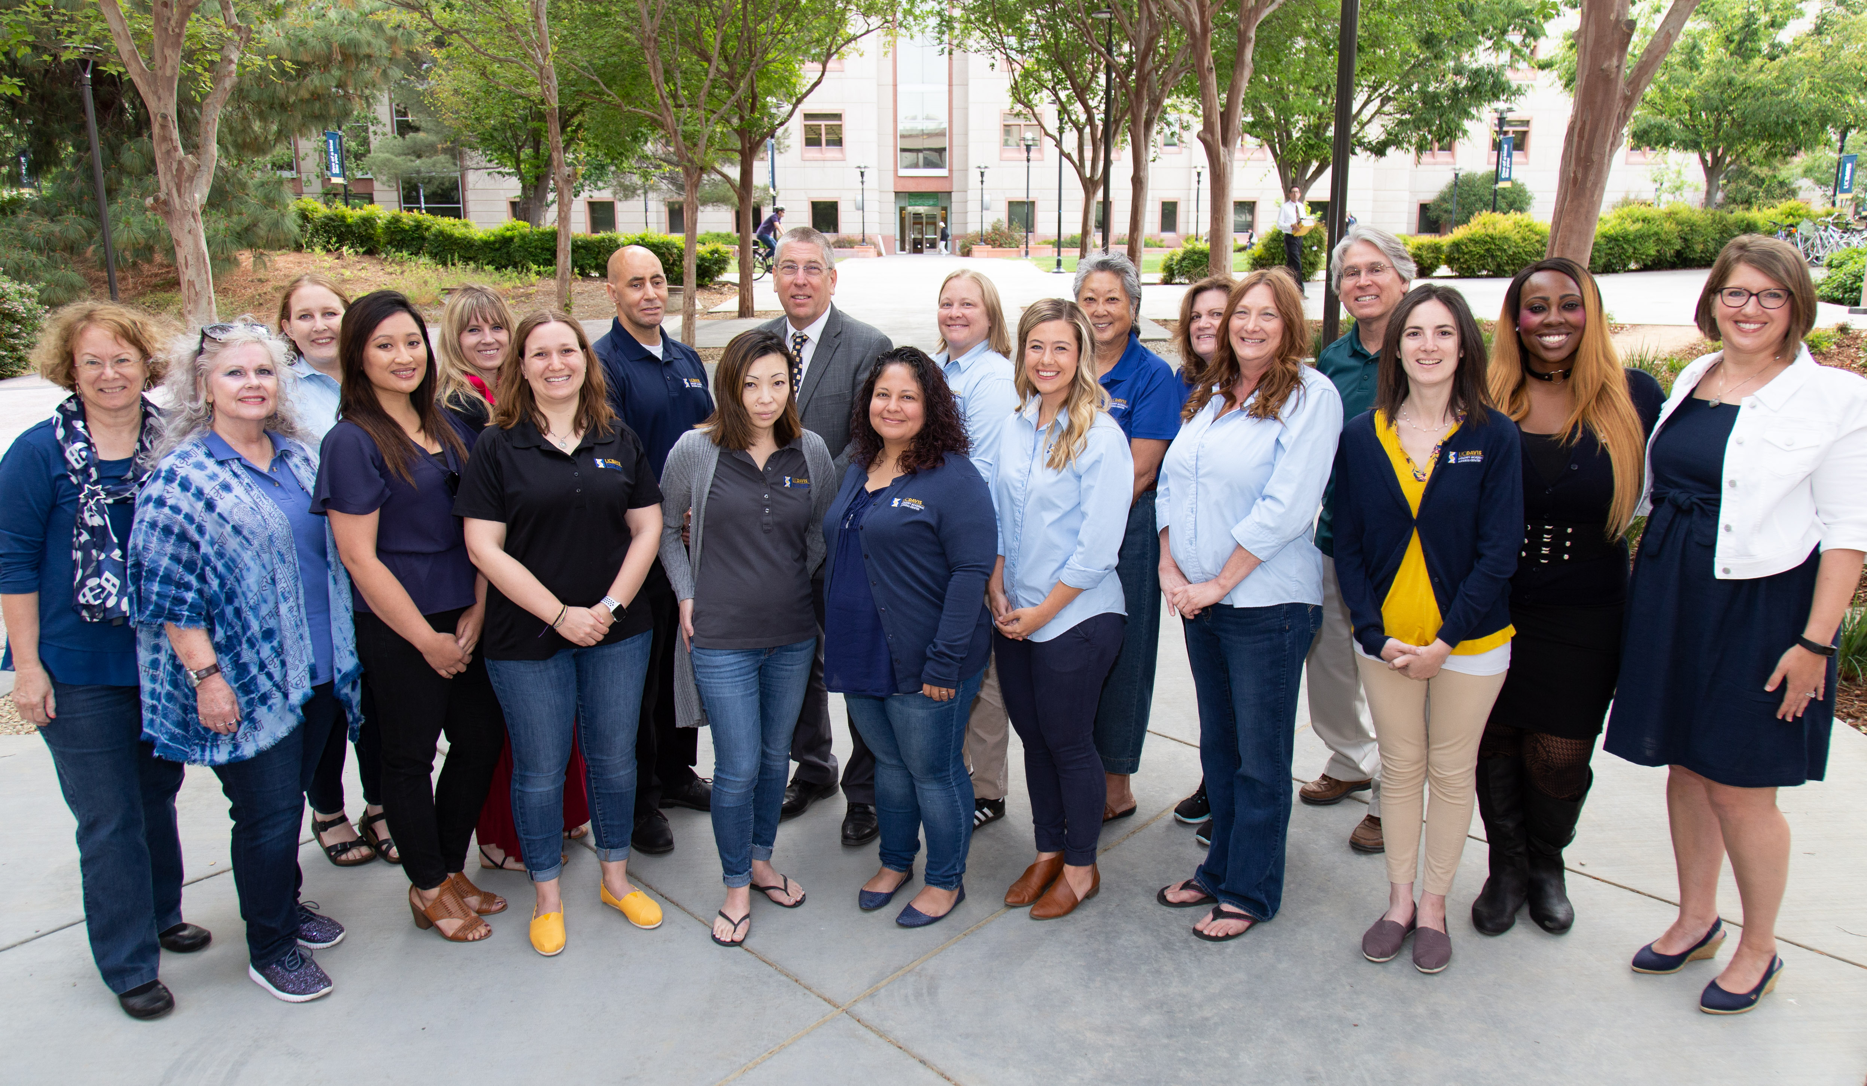
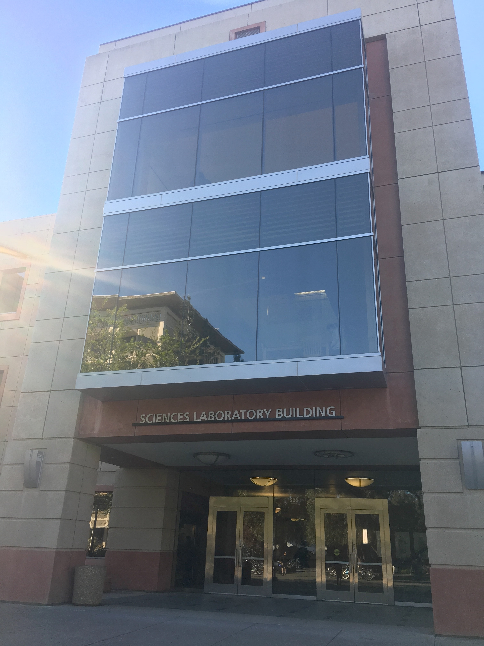
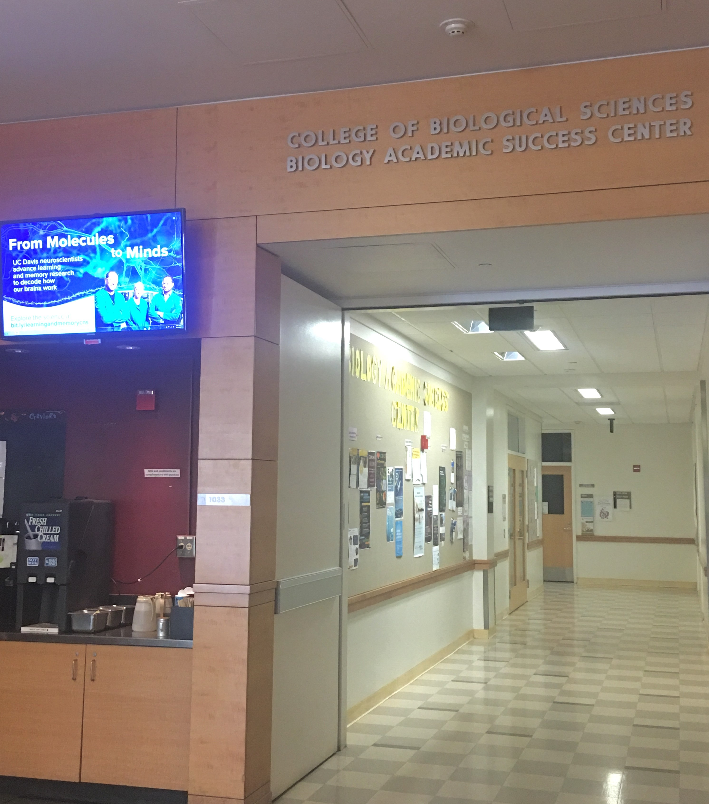
Biology Academic Success Center (BASC)
Mission: Empower College of Biological Sciences’ students to achieve their educational goals by encouraging: self-efficacy; the discovery of their own, unique academic path; and engagement within the College of Biological Sciences and the University of California, Davis communities.
Located in 1023 Sciences Lab Building (next to BioBrew)

Slide 4
Biology Academic Success Center (BASC)
    1023 Sciences Lab Building
    Front Desk: 530-752-0410
    Email: cbsundergrads@ucdavis.edu
    Appointments and Resources: basc.ucdavis.edu
  Services:
    Academic support—Academic and Dean’s Office advising in one place!
    Strategizing with you to meet graduation requirements (Major, GEs, College English Composition Requirement, etc.)
    Helping with academic difficulties
      Leave(s) of absence
      Petitions & exceptions
      Referrals to other campus resources

Slide 5
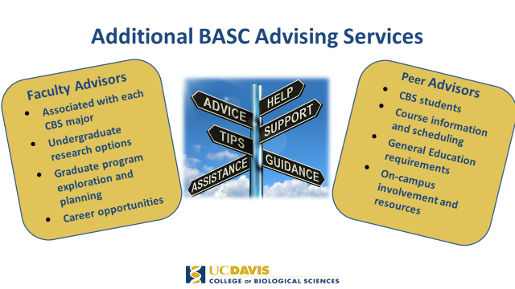

Slide 6
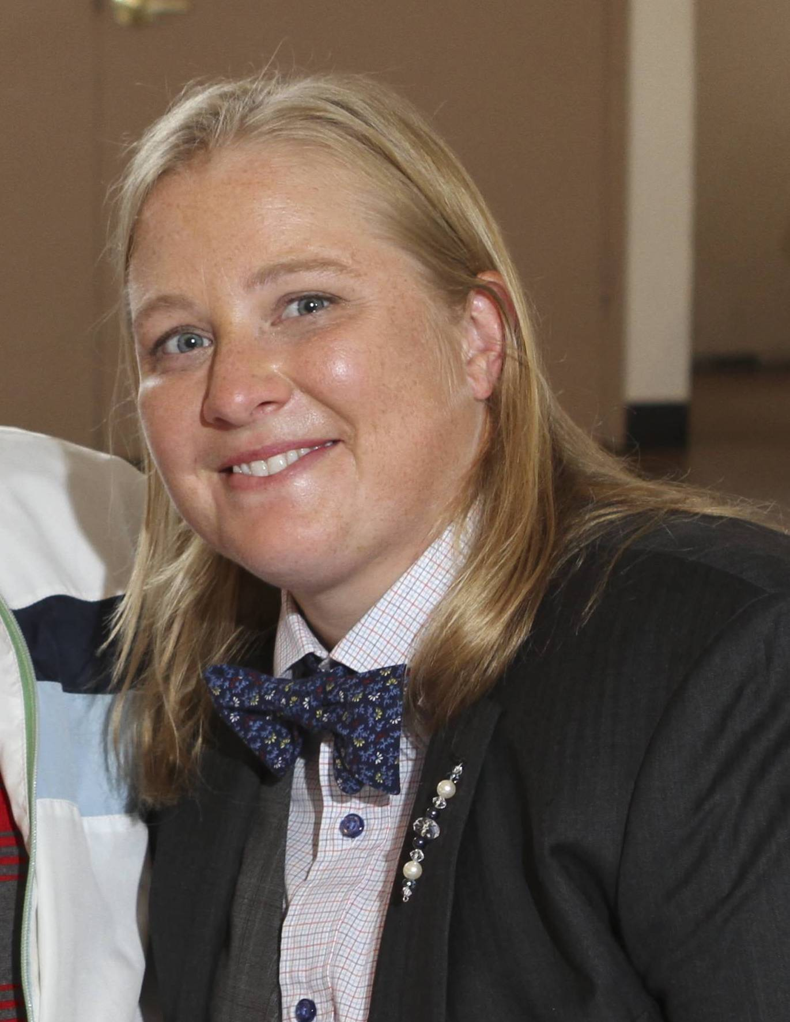
Student Health and Counseling Services:
Your College Counselor
Megan Brown, LCSW mgnbrown@ucdavis.edu
Offices located within BASC
and North Hall

Slide 7

Launch Mentor Collective
How does it work?
Follow the instructions in the email you received about how to participate.
Once you are registered, you will be asked to complete a survey asking about your background, interests, and what you are looking for in a mentor.
Based on your answers, you will be connected with a CBS junior or senior, who has volunteered to help you learn the ropes at UC Davis.
Notes:
Consider participant in a CBS mentoring program called Mentor Collective! You should have received an email during the week of July 15th with details about how to participate. Please follow those instructions to get involved. (share more information about the benefits of participating in a mentoring program)

Slide 8
How to Prepare for Registration
5 Steps to Success
  Review Placement Exam Scores: English, Math, and/or Chemistry; Confirm AP/IB/A-Level Scores (if any)
1
  Enter information into 1st Quarter Course Recommendation Tool
2
  Make online Aggie Advising appointment with BASC Academic Advisor to discuss schedule (See Q&As for details)
3
  Save preferred schedule and confirm Pass Time in Schedule Builder
4
  Register for courses during Pass 1
5
Notes:
1QCRT: When choosing General Education electives, remember that CBS major courses satisfy the Science and Engineering (SE) Topical Breadth requirement, as well as the following Core Literacies: Oral Skills (OL), Visual Literacy (VL), Quantitative Literacy (QL), and Scientific Literacy (SL).

Slide 9
Placement Exams and Scores
Entry Level Writing Requirement
Math
Chemistry
  Satisfied with one of the following:
    SAT/ACT/AP/IB Test Scores
    UC Davis Writing Placement
    ELWR Info
  Can meet the Math Placement Requirement with one of the following:
    AP/IB/A-Levels
    Placement Exam
    Math Placement Info
  Can meet the Chemistry Placement Requirement by:
    Chemistry Placement Exam (24+ for CHE 2A; 33+ for CHE 2AH)
    Chemistry Placement Info

Slide 10
Pass Times – Fall 2020
VISIT: registrar.ucdavis.edu
Pass 1 (July 6, 8:00 am – 12:00 or 1:00 – 5:00 pm);
Open July 6, 5:00 pm, July 7 and 8
Register for Recommended Courses; new seats released each Pass 1 period
Pass 2 (August 24 – September 4)
Register or Waitlist for Courses that were not available during Pass 1
Open Registration (September 5 – 14)
Any necessary changes to your schedule can be made at this time
Registration Freeze (September 15 – 18)
Advisors will be reviewing your schedules and may be suggesting changes
Schedule Adjustment (September 18, 6:00 a.m. – November 3)
Last chance to make schedule adjustments

Slide 11
What is a “good” schedule for fall quarter?
  Balanced schedule with 12-15 units
    How do I calculate total units?
    Workload units count. Ex: WLD 41C
  What do I do if a class is full?
    Waitlist during Pass 2 or Schedule Adjustment
    Select alternative classes
  Avoid time conflicts, both class and exam; make sure you have pre-reqs—Schedule Builder will block if you don’t
  Lower Division 1-99, Upper Division 100-199
    You should only be in lower division classes this quarter
  Credit for Writing Experience (WE) only after ELWR met
If you are unsure, ask your academic advisor!
Notes:
Pre-reqs—Schedule Builder will check
Writing Experience GEs—Only after ELWR

Slide 12
How do I know if my schedule is right for me?
Go to each class meeting the first week of instruction
Carefully review each syllabus
Talk to an advisor right away if you have questions or concerns about your course schedule
Courses have a 10-day or 20-day drop deadline
The last day to add a course is the 12th day of instruction

Slide 13
College of Biological Sciences
Policies and Procedures are specific to each College
Mandatory Advising
  Fall workshops to discuss academic success, student tools, resources, and policies
Holds
  Placed if you miss a deadline
  Contact the department that placed the hold
Check out our website! basc.ucdavis.edu

Slide 14
How do I choose my (major) courses?
  Look up the courses for your major using the General Catalog
1
  Start taking courses required for your major in your first quarter. If you want to change your major, take the courses required by the major that you plan to change to.
2
  Meet with your academic advisor in the fall to learn about how to change your major.
3

Slide 15
Majors
Evolution, Ecology and Biodiversity (EEB)
Molecular and Medical Microbiology (MMM)
Biochemistry and Molecular Biology (BMB) Cell Biology (CBI) Genetics and Genomics (GGN)
Neurobiology Physiology and Behavior (NPB)
Plant Biology (PLB)
Biological Sciences (BIS)
Marine and Coastal Sciences (MCS) -CBS hosts the Marine Ecology and Organismal Biology track

Slide 16
Recommended Courses by Major
BMB, CBI, GGN,NPB, Undeclared
BIS, MMM, EEB, PLB, MCS
Fall 2020
Chemistry
Math
Chemistry
Biology
BIS- Biological Sciences; CHE- Chemistry; MAT- Mathematics
If you enroll in any sort of WLD course, push these courses back for the appropriate number of quarters.

Slide 17
BIS 005
The Exploring Biological Sciences course BIS 005 is a low-intensity, one-unit, pass/no-pass, seminar-style class designed to familiarize you with the College of Biological Sciences through coursework and esteemed guest lecturers.
Gain firsthand knowledge about research opportunities and career paths from professors and researchers sharing their journeys
Build your professional skills: you'll create a LinkedIn profile and draft letters of interest to grow professional networks with your peers and faculty and researchers across campus and help identify research opportunities

Slide 18
What we covered:
Where to Get Advice
Changing Majors
How to Choose Your Courses
Registration
Units
Placement Exams and Scores
Pass Times and Waitlists

Slide 19
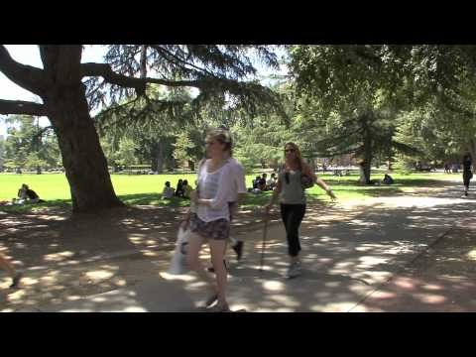
Watch: What I Wish I Knew as a First Year Aggie!

Slide 20
Questions and Answers
(Q & A)
  How do I make an Aggie Advising appointment with my BASC Academic Advisor?
Q 1
  BASC Website: https://basc.biology.ucdavis.edu/ >> Select Academic Advising >> Make an Appointment >> Follow directions
A 1

Slide 21
Questions and Answers
(Q & A)
  What can I expect from my Aggie Advising appointment?
Q 2
You will receive a questionnaire to help focus the appointment. You and your advisor will determine if you have the best fall schedule for you. Questions about other topics may be covered in a later appointment.
A 2

Slide 22
Questions and Answers
(Q & A)
  Do classes get more difficult when the course numbers get higher?
  For example: Is UWP 1 easier than UWP 21?
Q 3
  Not necessarily within lower division (1-99) or upper division (100-199) courses Many courses are not taken in order. Read the full course description in order to determine if you are prepared to take the course.
  Only take courses numbered 1 - 99 your first year at UC Davis. Do not register for courses numbered 100 - 199.
A 3

Slide 23
Questions and Answers
(Q & A)
  What do I do if a course that I want to take is full?
Q 4
  If a course is full you can add yourself to the waitlist during Pass 2 registration. (If another student drops this course, you may be added).
  However, there is no guarantee that you will be added to a waitlisted course. Use the “1st Quarter Course Recommendation Tool” to find another course in case you do not get into your first choice.
A 4

Slide 24
Questions and Answers
(Q & A)
  I have Advanced Placement (AP), International Baccalaureate (IB), and Advanced Levels (A-Level) Exam credit. Can I skip any classes?
Q 5
  Some AP and IB credit may allow you to skip a course; however, we do not recommend it. Exam credit is not the same as a University-level course.
  In some cases, you are not allowed to take a course that you have earned AP or IB credit for. Refer to the General Catalog or talk to your Academic Advisor.
A 5

Slide 25
Questions and Answers
(Q & A)
  Can I take more than 15 units?
Q 6
  New CBS students are strongly recommended to take only 12-15 units their first quarter. You can discuss increasing your units for winter quarter with your Academic Advisor.
A 6

Slide 26
Questions and Answers
(Q & A)
  What are the requirements to change my major?
Q 7
  Be in good academic standing.
  Have at least a 2.0
  Meet with an advisor from the major you intend to switch into. (Outside of CBS, may be add course requirements)
A 7

Slide 27
Questions and Answers
(Q & A)
I am an Undeclared-Life Sciences major, how do I declare my major? Do I have to declare my major by a specific time?
Q 8
Students who are Undeclared-Life Sciences majors must declare a major before reaching 90 units (not taking into account AP/IB units). Delay in declaring your major will result in a registration hold.
A 8

Slide 28
Questions and Answers
(Q & A)
Can I take some of my courses as Passed/Not Passed (P/NP)?
Q 9
Maximum P/NP Units is one-third of units completed at UC Davis.
Courses for your major must be taken for a letter grade, unless only offered as P/NP grading.
A 9

Slide 29
Questions and Answers
(Q & A)
Can I repeat a course more than once?
Q 10
You are allowed to repeat a course one time for credit only if you received a D+, D, D-, or F grade. If you wish to repeat a course for a second time you must receive permission to do so before you enroll in the class for the third time. A Multiple Repeat Petition will need to be submitted and approved to enroll in the class.
A 10

Slide 30
Questions and Answers
(Q & A)
I am an international student. Are there any special restrictions I should know about?
Q 11
To maintain your immigration status, you must have registered for 12 units or more by the 12th day of instruction. Waitlisted courses do not count.
Be sure that you understand the ELWR (Slide 8) and the American History & Institutions requirement. If you have questions about these or related matters, contact the CBS International Academic Advisor.
A 11

Slide 31
For More Information
    1023 Sciences Lab Building
    Front Desk: 530-752-0410
    Email: cbsundergrads@ucdavis.edu
    Appointments and Resources: basc.ucdavis.edu

