Slide 1
Welcome to the College of Biological Sciences (CBS)!
Notes:
Advisor introductions

Slide 2
Today’s Agenda
Introductions
Overview of Biology Academic Success Center (BASC)
Expectations
College of Biological Sciences Degree Requirements
Important Advising Tools and Resources
Fall 2019 Schedule Preparation
Q&A

Slide 3
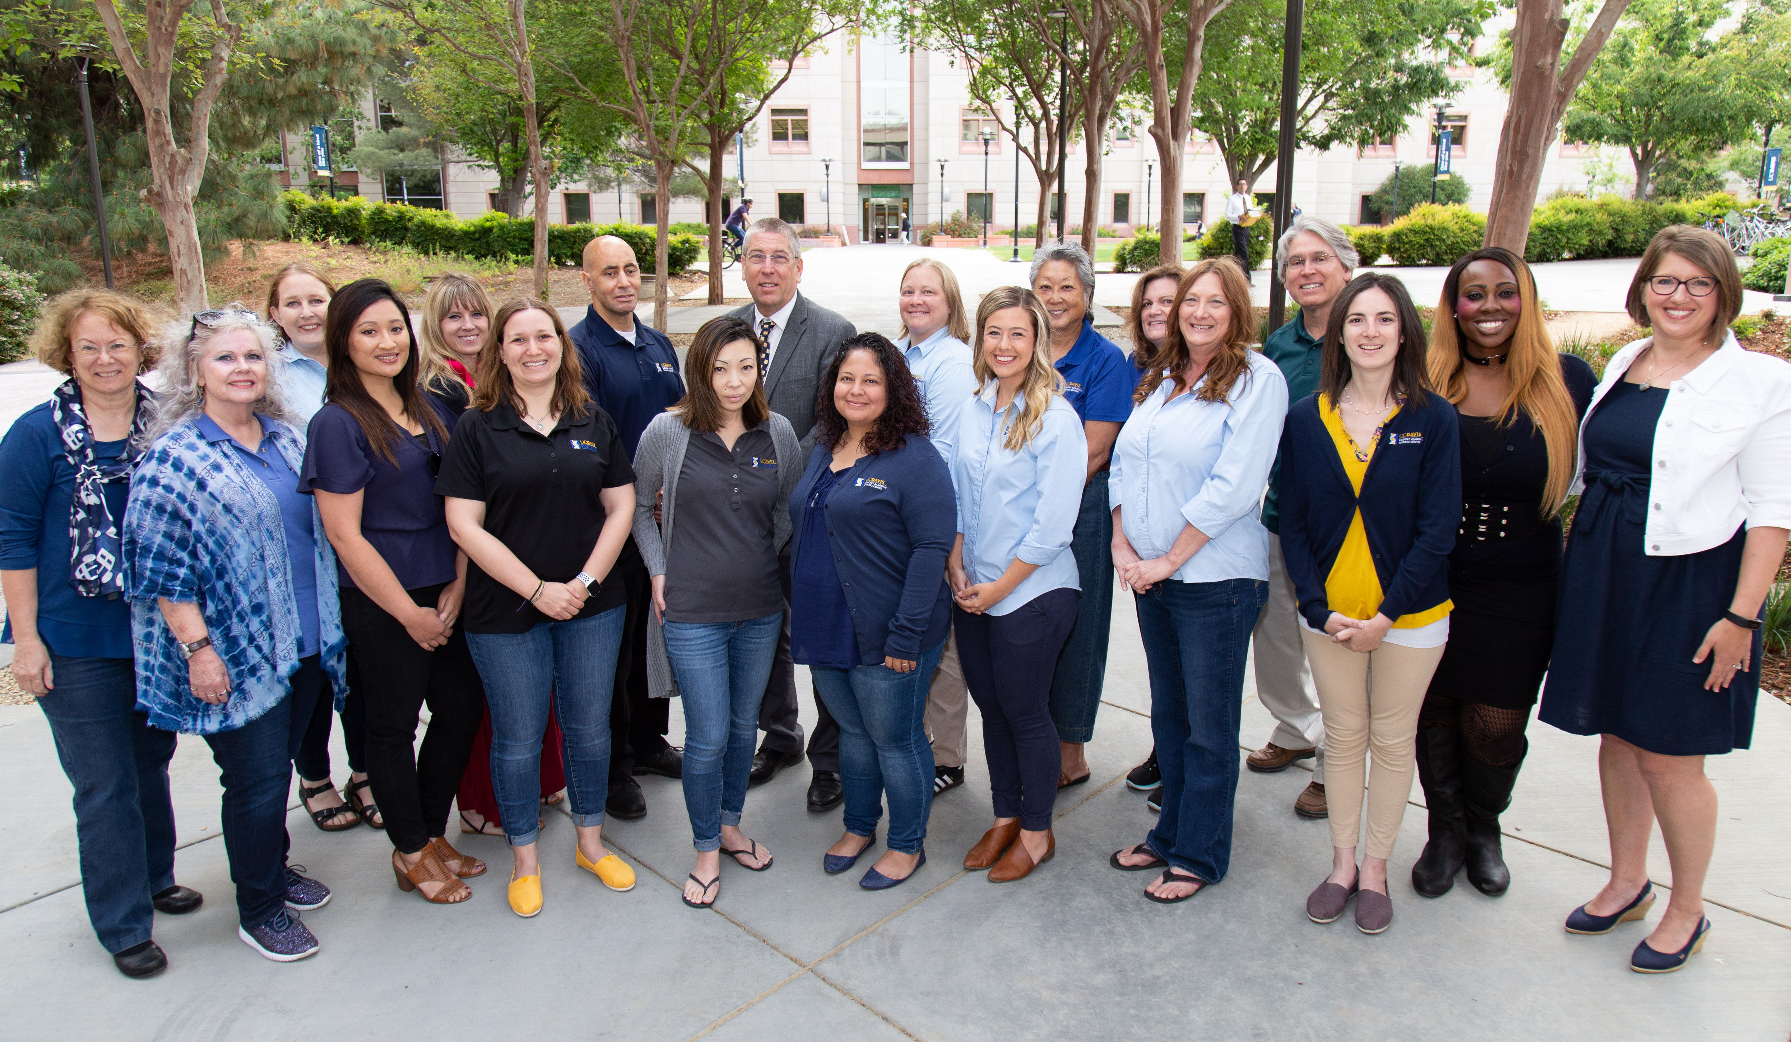
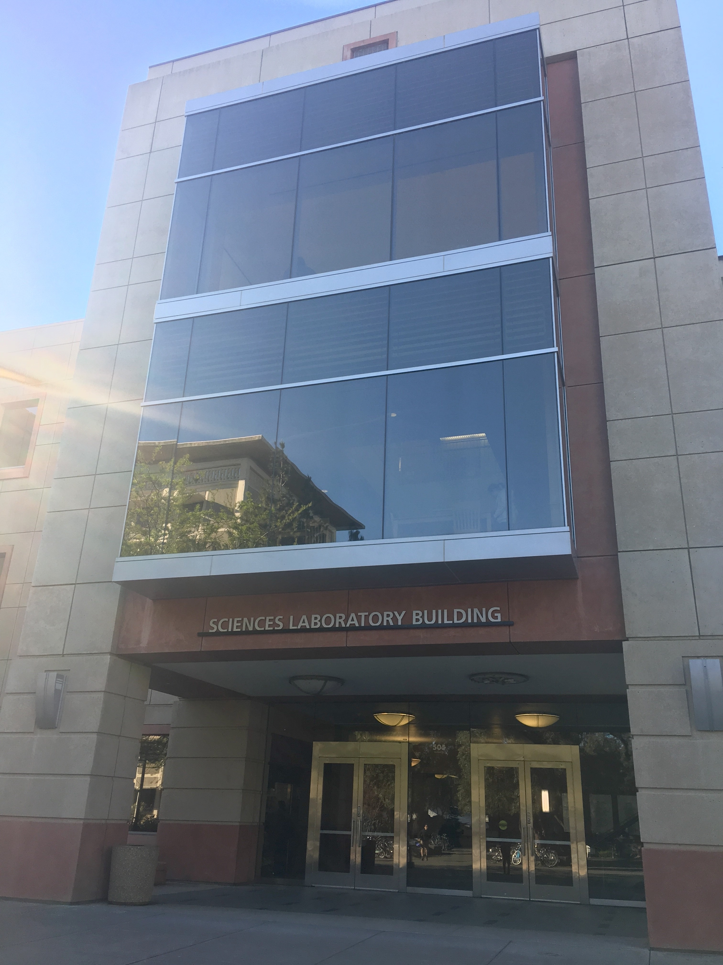
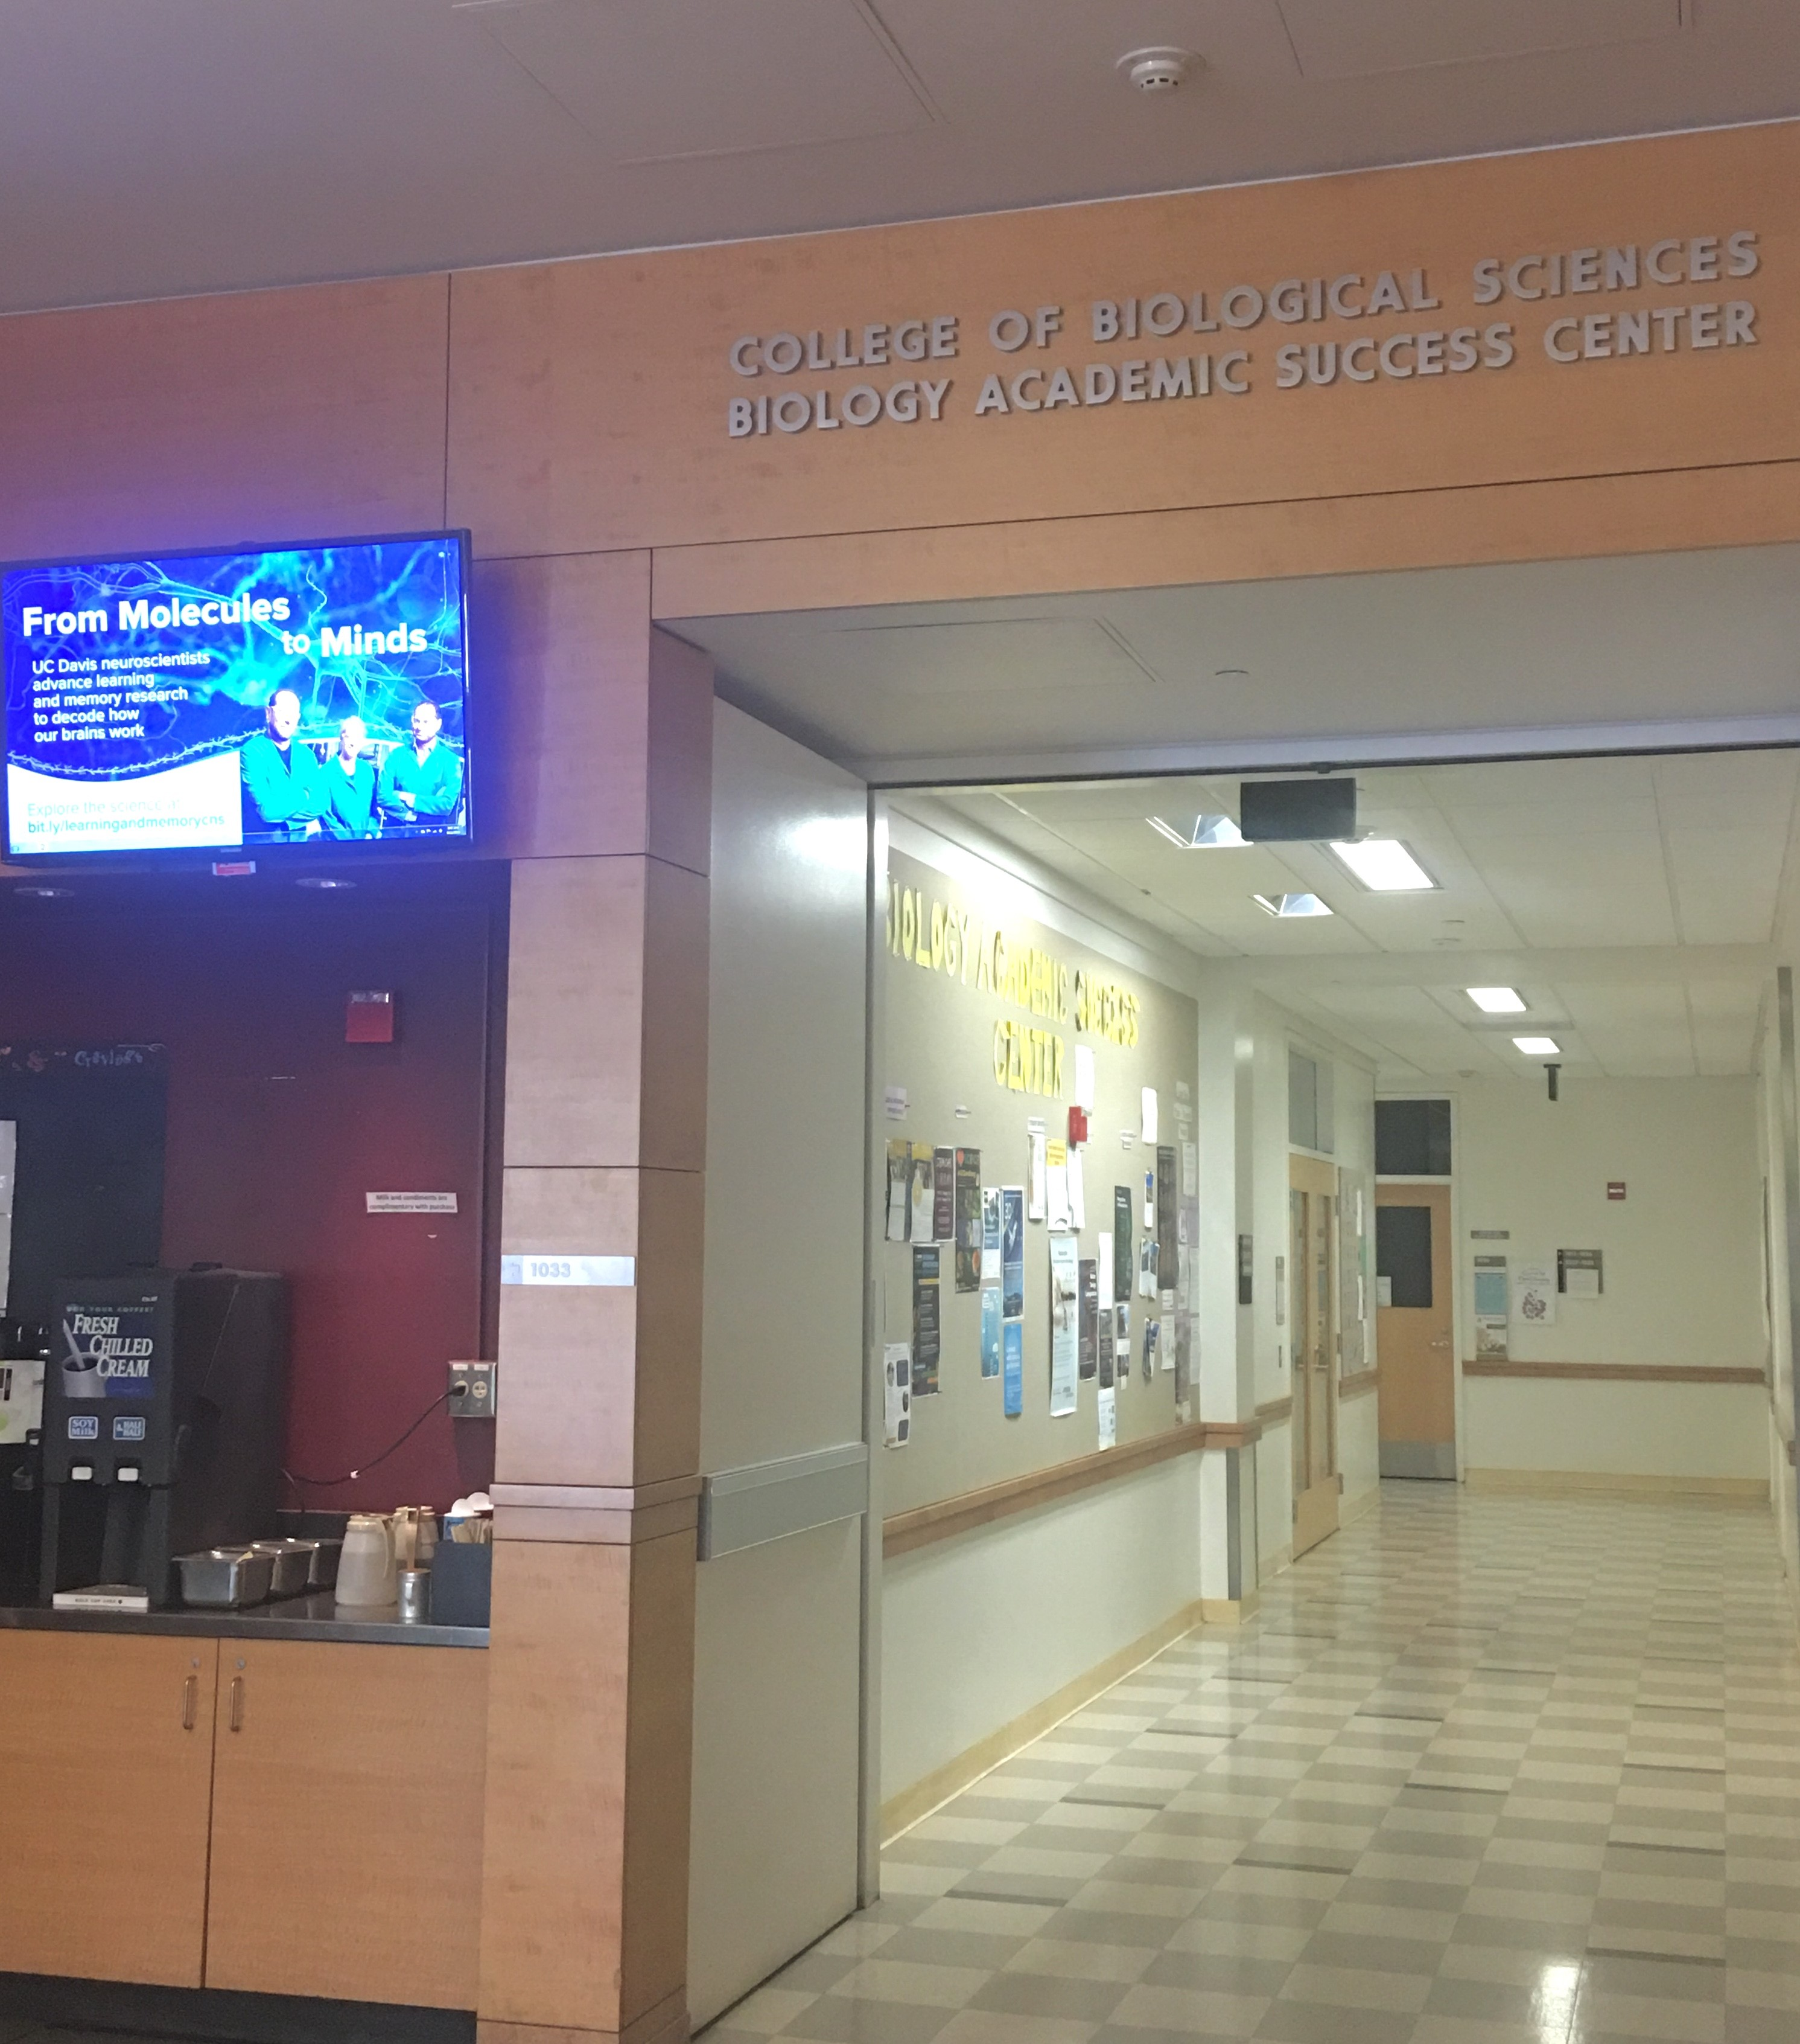
Biology Academic Success Center (BASC) Mission: Empower College of Biological Sciences’ students to achieve their educational goals by encouraging: self-efficacy; the discovery of their own, unique academic path; and engagement within the College of Biological Sciences and the University of California, Davis communities.
Located in 1023 Sciences Lab Building (next to BioBrew)
Notes:
You might be wondering who we are? We are the Biology Academic Success. Our office is located in the Lab Sciences Building right next to Bio Brew. Our team consists of many staff members and we are all proud to be professional Aggies!
We’re your GPS system!

Slide 4
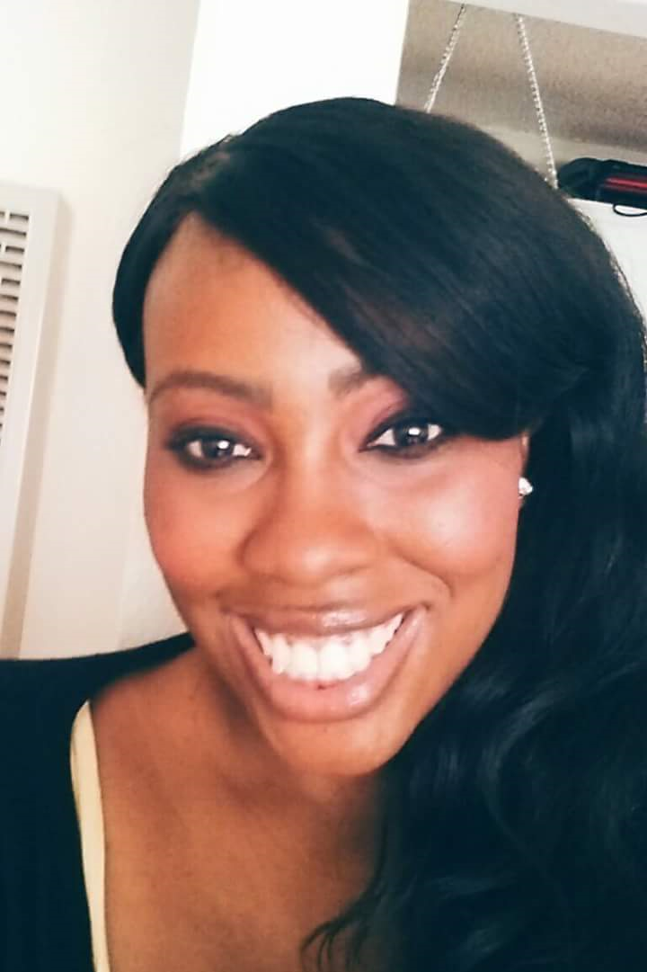
Your BASC International Advisors
Jeff Davis
Yasmine V. Jefferson
Notes:
BASC has dedicated advisors to help international students excel at UC Davis.
For National students, major advisors are available. Yasmine is also an NPB advisor.

Slide 5
Additional BASC Advising Services
Faculty Advisors
Associated with each CBS major
Undergraduate research options
Graduate program exploration and planning
Career opportunities
Peer Advisors
CBS students
Course information and scheduling
General Education requirements
On-campus involvement and resources
Notes:
Share some details about faculty advising and peer advising. So many resources to help you succeed!

Slide 6
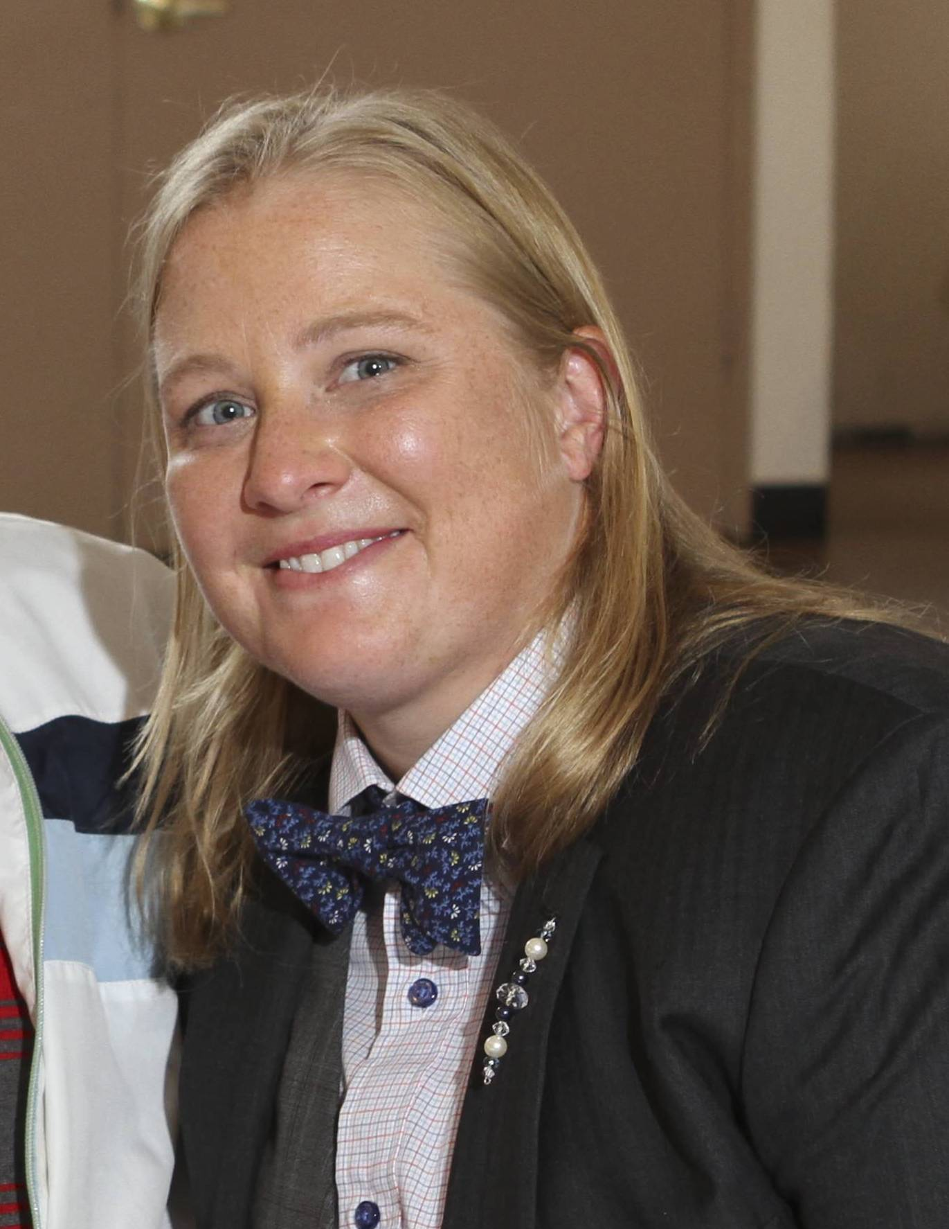
Student Health and Counseling Services:
Your College Counselor
Megan Brown, LCSW mgnbrown@ucdavis.edu
Offices located within BASC and North Hall
Notes:
Introduce our embedded CBS counselor, Megan Brown!
Transition period of your lives: stress-related issues, anxiety, relationships.

Slide 7
SISS – Services for International Students and Scholars
Notes:
BASC works closely with SISS.

Slide 8
SISS
Assists incoming and current international students and scholars, and their families with visa and immigration issues while they are at UC Davis.
Assists international students and scholars in maintaining their legal status while in the United States.
Provides orientation, assistance, information, and referral to international students, faculty, and researchers regarding financial, personal, cultural, and academic concerns.
Advising for Students
Drop-In Advising: Students can see an Advisor during our drop-in periods ("drop-in" means you don't need an appointment) Monday afternoons 1 to 3:45 PM, Thursday afternoons 1 to 3:45 PM.
Advisor Appointments: Students and Scholars can also schedule an appointment with their advisor Monday through Thursday from 9 AM to noon, and 1 to 4 PM. You can make an appointment either at the SISS front desk or by calling 530-752-0864 ext. 0.

Slide 9
Health Professions Advising (HPA)
hpa.ucdavis.edu
Health Professions Advising is your go-to place if you are planning to pursue a health profession or allied health field.
One-on-One Advising
Drop-In Hours
Small and Large Group Sessions
Notes:
Introduce HPA as a beneficial campus resource
How many plan to pursue health-related professions?

Slide 10
Launch Mentor Collective
How does it work?
You will receive an email providing you with a registration link.
Once you are registered, you will be asked to complete a survey asking about your background, interests, and what you are looking for in a mentor.
Based on your answers, you will be connected with a CBS junior or senior, who has volunteered to help you “learn the ropes” at UC Davis.
Notes:
Consider participating in a CBS mentoring program called Mentor Collective! You should have received an email during the week of July 15th with details about how to participate. Please follow those instructions to get involved. (share more information about the benefits of participating in a mentoring program)
What’s a mentor? What is “learn the ropes”?

Slide 11
Introductions: Meet Merle the Squirrel!
Look out for emails from Merle!
First-Year Tips
Deadlines
Suggestions and More!
Notes:
One more introduction we want to make is of our new First-Year Academic Advising mascot. Meet Merle the Squirrel! Look out for emails throughout your first year from Merle about important first-year tips, deadlines, and suggestions!

Slide 12
CBS International Student Bulletin
Weekly during the academic year
For BASC international and other announcements
Recommendations for academic success and well-being
Reminders of due dates and other important items
Cultural notes
Don’t miss it!

Slide 13
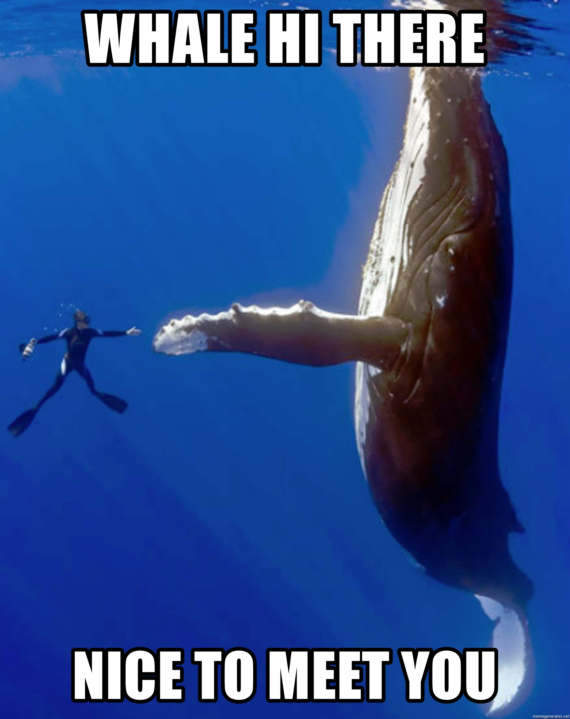
Introductions: Meet another CBS Major
Name
One thing that interests you about majoring in the College of Biological Sciences
What you are most looking forward to in your first quarter at UC Davis
One of the most recent books you’ve read or TV shows you “binge-watched”
Notes:
Now you know a little more about us, we want to hear from you. By a show of hands, who is from the Sacramento region? Bay area? Other NorCal locations? Central CA? SoCal? NotCal? Which countries?
The purpose of our presentation is to help you gain a better understanding of your home College and advising services here at UC Davis. This includes getting to know your peers who are part of the College of Biological Sciences. We would like to give you the opportunity to meet someone new. Please find someone (this can be groups of three) you don’t already know and take a few minutes or so to meet a potential new friend within CBS by sharing the following details about yourself: name, one thing that interests you about majoring in the College of Biological Sciences, what you are looking forward to most about your first quarter, and one of the most recent books you’ve read or TV shows you binge-watched. [define binge-watched]

Slide 14
Understanding Expectations
15 in class hours/week; 2-3 outside of class hours per unit/week
Attend office hours
Make time for advising meetings (schedule appts. in advance)
Time Management
Academic Planning
Syllabus is a
contract between you and instructor
You arrange
your schedule
Plan to meet with BASC advisor, especially for first-year mandatory advising in the fall!
Responsibility
Reach out for help
Utilize campus resources and
follow-up
Meet with BASC advisor early
Track degree progress
Use resources
to understand requirements
Confirm degree requirements with BASC advisor
Seeking Help
Degree Requirements
Notes:
To better understand how advisement works in the College of Biological Sciences, we want to first discuss the expectations for UC Davis students as you are preparing to transition to UC Davis. There are four main categories that impact your academic success we would like to focus on: Time Management, Academic Planning, Seeking Help, and Degree Requirements. While each category differs, the expectations all relate to student responsibility.
As you can see here, we will briefly describe each category of expectations as it relates to your responsibility.
For example, students are responsible for managing their time. While you may be in class “only” 15 hours a week, you will be expected to spend approximately 2-3 hours per enrolled unit, per week, outside of class. You’ll also need to make time for attending office hours, tutoring, advising meetings and campus workshops of interest. Being a full-time student is more than a full-time job!
With regard to academic planning, your instructors will provide a syllabus for each course. This is a contract between you and the instructor. The instructor provides you detailed information about course expectations, policies, guidelines, and grading. You are expected to read the syllabus and refer to it whenever you should have a question about the course. It is also a tool for you to use when planning how you will use your time each week to complete course requirements. You are not only responsible for planning how you will use your time, you are responsible for creating your own schedule for every quarter. It is also crucially important to meet with a BASC major advisor throughout your undergraduate experience, but you MUST meet with a BASC major advisor in the fall for mandatory advising. You will discuss important information related to your degree requirements and available supportive resources. You also will not be able to enroll in a future quarter without completing mandatory advising.
Last, but certainly not least, UC Davis expects its students to reach out for help when they need it. There is no shame, and certainly no harm, in asking questions and expressing that you need help. UC Davis has developed many supportive services on campus to help you achieve academic success, including an entire success center devoted to you! We will review where to find more information about these services soon. Please make sure to utilize campus resources while you are here!

Slide 15
BASC Advising Related Expectations
Students | Advisors
Read UCD email daily; be aware of important deadlines | Share opportunities and important deadlines
Schedule and attend First-Year Mandatory Advising before spring quarter enrollment | Provide safe and inclusive space for you; listen carefully to your questions and concerns
Prepare for advising meetings | Prepare for advising meetings
Regularly utilize academic tools: OASIS, Schedule Builder, My Degree, Canvas | Encourage and guide curriculum exploration, understanding requirements, and utilization of advising tools and supportive services
Contact advisor regularly | Is accessible during advising hours
Notes:
Review expectations of both students and of BASC advisors—they parallel one another. Also, Reminder Meme about needing to complete mandatory advising before spring quarter enrollment—will have advising hold preventing spring registration.

Slide 16
BASC Advising Options
Scheduled Appointments
Express Advising
Available Monday-Friday
30 minutes
Schedule with BASC Major Advisor
Available three days a week
15 minutes
Specific Topics ONLY
Notes:
To be determined

Slide 17
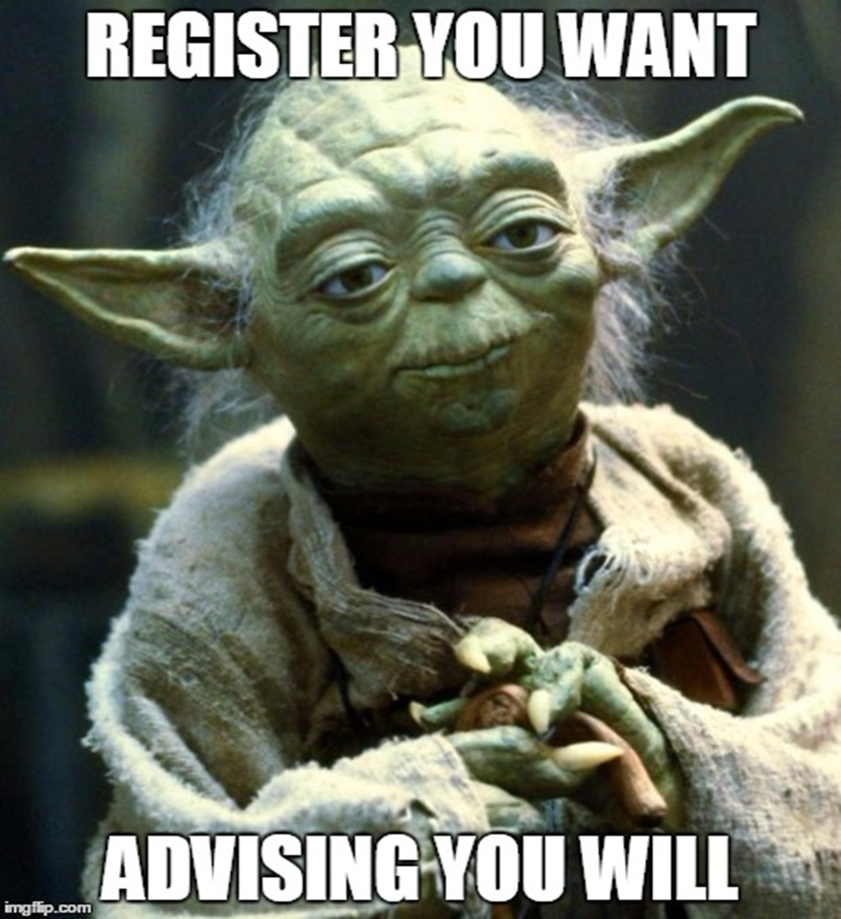
First-year Mandatory Advising
Required of all new CBS students before registration for Spring 2020 quarter
New group format
Learn about all the ways you can excel at UC Davis!

Slide 18
Learning Check!
Who should you go to for academic advising as a College of Biological Sciences (CBS) major?
A. Trained BASC Peer Advisor
B. Friend
C. BASC Advisor
D. CBS Faculty Advisor
E. All except for B
Notes:
By a show of hands, who thinks the answer is A? B? C? D? E?
Answer: E

Slide 19
Learning Check!
Mandatory Advising must be completed by all first-year students within the first year before spring quarter course registration begins.
True or False?
Notes:
By a show of hands, who thinks it is True? False?
Answer: True
MEME: Encourage students to avoid waiting last minute to schedule MA appointment

Slide 20
Learning Check!
How much time should you expect to spend outside of class per unit each week?
A. 30 minutes
B. 2-3 hours
C. 4-5 hours
D. None. I got this.
Notes:
By a show of hands, who thinks it is A? B? C? D?
Answer: B

Slide 21
College of Biological Sciences Quick Facts
Values
Scientific innovation and discovery
Highest standards of excellence in:
Teaching
Research
Community Involvement
47% of CBS undergraduates participated in research and 71% in an internship (2017-18)
Over 40,000 alumni
2 Degree Options: A.B. and B.S.
9 Majors and
7 Minors
5 Departments
Notes:
4 colleges in the University. Review CBS Quick facts before jumping into degree requirements

Slide 22
College of Biological Sciences (CBS) Degree Requirements Structure
Electives
CBS
University and GE
Major
Total Units: 180
Approx. 15 units needed each quarter to total 180 units
There’s more to your degree than major requirements!
Notes:
Our College offers many majors within different degrees, but each degree has four components: Major, University and GE, College of Biological Sciences Requirements, and Electives.
Each degree requires 180 units. This means students need to complete about 15 units every quarter for the next twelve quarters to reach 180 units. Each student’s plan will look different depending on many factors such as transfer units, AP/IB credit, IGETC, and potential summer sessions, but an important takeaway from this information is that there are four components to your degree.
Each degree consists of more than major requirements and requires at minimum 180 units.

Slide 23
College of Biological Sciences (CBS) Degree Structure
Electives
CBS
University and GE
Major
73-125 units
No major courses can be selected to take as P/NP
Minimum 2.0 GPA in major coursework
Notes:
Let’s first talk about the major requirements. Depending on your chosen CBS major, you may be required to complete 73-125 units of specific major coursework. Any course you take to fulfill a CBS major requirement CANNOT be selected to take P/NP. If the course is a letter-graded course, you must take the major course for a letter-grade. The minimum required CBS Major GPA is 2.0.

Slide 24
College of Biological Sciences (CBS) Degree Structure
Electives
CBS
University and GE
Major
Entry-Level Writing Requirement
American History and Institutions
General Education (Topical Breadth- 52 units and Core Literacies- 35 units)
Minimum 2.0 UC Davis cumulative GPA
Notes:
University and GE requirements make up another large portion of your degree here at UC Davis. In addition to ELWR and AHI, you must complete two large sections of GE: Topical Breadth and Core Literacies (we will share more details about this later in our presentation). You also must have a 2.0 cumulative UC GPA to be in good academic standing and to graduate.
Int’l stds: Don’t forget the AHI requirement! Not the same as ACGH. Several options; doesn’t have to be US History.

Slide 25
Ways to Satisfy ELWR BEFORE Starting at UCD
ACT | SAT | AP | IB | AWPE
30+ English Language Arts OR 30+ Combined English/Writing | 680+ Evidence-Based Reading and Writing OR 680+ Reasoning Test, Writing | 3+ on either AP Exam in English (Language and Composition or Literature and Composition) | 5 or 6 on IB Standard or Higher Level English A: Literature Exam OR 5 or 6 on IB Standard or Higher Level English A: Language and Literature exam | Passing score on the Analytical Writing Placement Exam
NOTE: A grade of C or higher in an acceptable English composition course offered by a college or university (must be completed prior to entering UC) will also satisfy ELWR
UWP 7, 7m, WR 39A (online course)
OR
ENL 3 + 3A, NAS 5 + 5A, or UWP 1 + 1A
(concurrent enrollment required)
Ways to Satisfy ELWR AFTER Starting at UCD
(Must be for a letter grade!)
Notes:
There are many ways to satisfy ELWR (ACT, SAT, AP, IB, and AWPE). Please review this chart.
ELWR is not the same as Lower and Upper Division Comp req! WLD 57 available through Winter 2020 for National students.

Slide 27
College of Biological Sciences (CBS) Degree Structure
Electives
CBS
University and GE
Major
English Composition (8 units)
Foreign Language (for A.B. degrees)
At least 64 upper division (100 level) units
Minimum 2.0 GPA in major and depth (100 level) units
Notes:
The CBS requirements consist of 8 units of English Composition, at least 64 upper division units, and a minimum of 2.0 GPA in major and depth units to graduate. If you are working toward a Bachelor of Arts degree, you will also need foreign language.

Slide 28
Fall 2019 Scheduling Preparation: CBS Core Curriculum
MATH (MAT)
17A, 17B, and 17C (or 21A and 21B)
GENERAL CHEMISTRY (CHE)
2A, 2B, and 2C
BIOLOGY (BIS)
2B, 2C, and 2A
ORGANIC CHEMISTRY (CHE)
8A and 8B OR 118A, 118B, and 118C (128ABC and 129AB also accepted)
PHYSICS (PHY)
7A, 7B, and 7C (or 9ABC)
Same preparatory courses for all CBS Bachelor of Science degrees
Organic Chemistry and Physics differ by major and career interests
Notes:
Briefly review CBS Core Curriculum and consider mentioning AB first quarter coursework if advising for AB major(s)

Slide 29
College of Biological Sciences (CBS) Degree Structure
Electives
CBS
University and GE
Major
Exploration
Study Abroad
Minor(s) or Double Majors
Graduate and Professional School Preparation
Notes:
Electives are also part of your degree and often to help you reach the minimum units needed for the degree. Elective units may be utilized for exploration, study abroad, or even an additional academic program. However, it is important to discuss your interest in any additional academic programs with your advisor during mandatory advising this fall or early winter quarter as there are some additional guidelines that must be followed, including a unit cap.

Slide 30
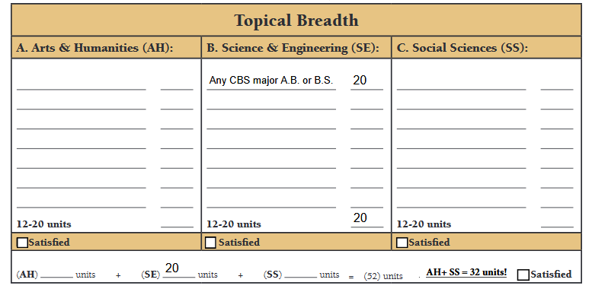
General Education (GE) Review: Topical Breadth
Notes:
I’ll bet I scared you when I told you the number of hours of GEs you need, but it’s not as bad as it seems. Reiterate that CBS students will have SE covered by major requirements, but will need a combined total of at least 32 units of AH and SS. First quarter schedules will most likely have at least one, if not more AH/SS GE courses included.

Slide 31
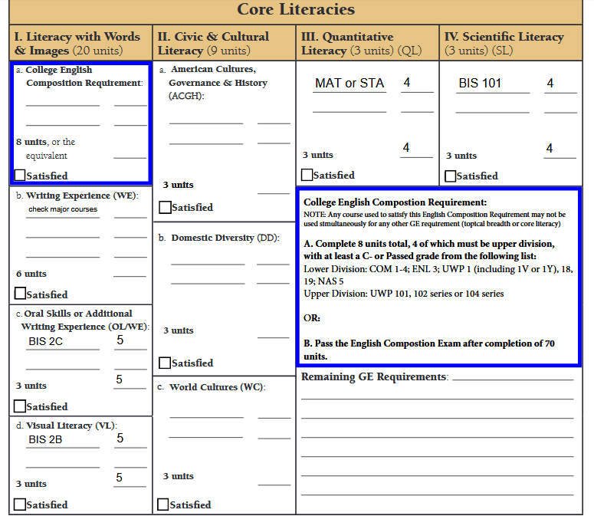
General Education (GE) Review: Core Literacies
NOTE: If you have completed a partial or full IGETC, please consult with a BASC advisor.
Notes:
Core Literacies is the other portion of GE. Inform students that many of these requirements will also be fulfilled by their major AND a course that fulfills Topical Breadth could fulfill one Core Literacy requirement if the chosen course includes both components. Emphasize double dipping is allowed, but not triple dipping AND English Composition cannot double count with anything else. Continue the focus on choosing GE AH or SS for fall quarter and reassure students that more information about GE will be shared during mandatory advising during fall or early winter quarter.
Note GE and FRS list on BASC site under Student Resources, then Newly Admitted Students.

Slide 32
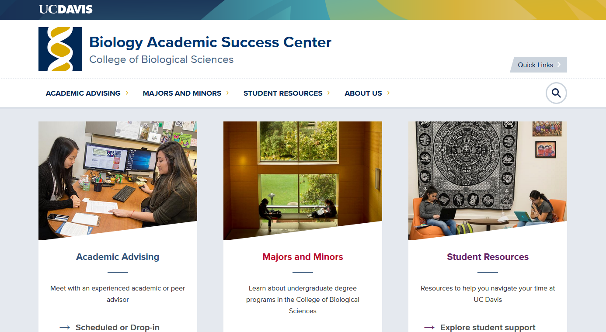
Advising Tools and Resources: BASC Website
https://basc.biology.ucdavis.edu/
Notes:
Ask students to form pairs or triads and pull up the BASC website on one laptop. Share that the next activity will require some teamwork as they get familiar with utilizing there one-stop-shop advising website. Directions to get students set-up and comfortable using the BASC website:
Ask students to scroll over each main tab to see sub-sections.
-Point out the Schedule an Appointment sub-section under Academic Advising.
-Inform students that all CBS majors are included under the Majors and Minors tab and they can view more information by selecting a major, including a GE chart.
-Share with students that there are helpful resources under the student resources tab and they will want to explore the newly admitted students, current students, and international students sub-sections for more information.
--The International page under Student Resources includes the online academic advising and registration presentation sent out during the summer.
-Finally, share with students that they can find bios of all BASC related advisors (staff, faculty, peer advisors) under the about us section along with contact information.

Slide 33
BASC Website Scavenger Hunt!
https://basc.biology.ucdavis.edu/
1) Select a major under the “Major and Minors” tab to then select “GE Chart” to open document. How many units of Topical Breadth: Science and Engineering (SE) will any CBS major have completed?
2) What is the total number of combined units of Topical Breadth: Arts and Humanities (AH) and Social Sciences (SS) a CBS major must complete?
3) Go to “Student Resources” and select “Current Students.” From the five main sections included, what section would you go to for tutoring or success coaching information?
Notes:
Ask students to work in their pairs or triads to find the answers to these four questions and as soon as they have the answers to all 4, raise their hands to share--The team may get a prize! (CBS swag)
KEY:
20
32
Be Academically Successful

Slide 34
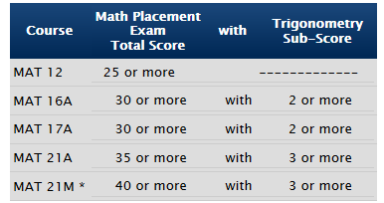
Fall 2019 Scheduling Preparation: Math Placement:
Write your math placement total score and trigonometry sub-score in the spaces provided on your half-sheet.
Write the corresponding math course based upon your scores
NOTE: CBS does not recommend skipping MAT 17A/21A with a passing AP score.
AP classes do NOT reflect the same rigor as UCD math classes (IB is different)
Notes:
Give direction to students to find their MAT Placement Score and Trig Sub-Score in OASIS.
*MAT 21M only recommended for students with 5 on AP Calculus exam (preferably BC) and are interested in abstract math. Student should consult with advisor before registering. Satisfies 21AB but not pre-med.
IB scores: Student must skip; cannot take for credit.

Slide 35
Fall 2019 Scheduling Preparation: Chemistry Placement
Enroll in CHE 2A
OR
CHE 2AH (if 33+ or higher)
UCD Chemistry Placement Exam score of 24+ on first attempt
Meets criteria
(optional path)
Does not
meet criteria
Preparatory Path 1: Complete ALEKS
100% Mastery Recommended
Eligible to retake UCD Chemistry Placement Exam
Score of 24+
Preparatory Path 2: Complete WLD 41C with C or higher
Does not
meet criteria
Meet with your advisor
Notes:
Must successfully complete CPE with 24+ to enroll in CHE 2A—no exceptions. We encourage all of our students to get started in CHE (that includes WLD 41C) in the first year. 41C only offered in fall.
Give students direction to see score in OASIS (should be posted 5-7 days after taking exam).

Slide 36
Fall 2019 Scheduling Preparation: Recommended Major Courses
Circle the recommended course combination per your intended major and placement in the spaces provided on your half-sheet.
Biochemistry and Molecular Biology (BMB)
Cell Biology (CBI)
Genetics and Genomics (GGN)
Neurobiology, Physiology, and Behavior (NPB)
Undeclared
Biological Sciences (BIS)
Evolution, Ecology, and Biodiversity (EEB)
Marine and Coastal Science (MCS)
Microbiology (MIC)
Plant Biology (PLB)
Chemistry (CHE)- WLD 41C or CHE 2A
Math (MAT)- WLD 55M, MAT 12, MAT 17A, or MAT 21A
Chemistry (CHE)- WLD 41C or CHE 2A
Biology (BIS)- BIS 2B
If received 4 or 5 for AP Chem., may take BIS 2A
Notes:
Circle one set of courses under the Recommended Beginning Major Courses section of your worksheet. As a reminder, if you are unable to get both recommended major courses or feel more comfortable starting with one, that is okay. If the hope is to gain enrollment in a major course that is full, you will have the opportunity to waitlist during Pass 2. Pass 2 begins August 26th
-If students have questions about starting with BIS 2A instead of 2B who have not received a 4 or 5 on AP Chem exam, share the preferred sequence is BIS 2B, 2C and then 2A.
-Encourage students to begin MAT 17A or MAT 21A as well as CHE 2A even if they have AP/IB credit

Slide 37
Fall 2019 Scheduling Preparation: What types of courses should I take?
PLAN A
Major Course
Major Course
Non-Major or GE
If ELWR is not satisfied, ELWR course
If ELWR is satisfied, Lower Division Composition or GE
Non-Major or GE
TOTAL UNITS: 15
PLAN B
Major Course
GE
Non-Major or GE
Non-Major or GE
If ELWR is not satisfied, ELWR course
If ELWR is satisfied, Lower Division Composition or GE
TOTAL UNITS: 15
PLAN C
GE
GE
Non-Major or GE
Non-Major or GE
If ELWR is not satisfied, ELWR
If ELWR is satisfied, Lower Division Composition or GE
TOTAL UNITS: 15
Notes:
You might be wondering what your schedule should consist of for your first quarter. There are three options as you see here between Plan A, B, and C. with a campus expectation of 15 units, on average, per quarter. If possible, attempt for Plan A, but if that doesn’t work or you don’t feel comfortable with that plan, try for Plan B. If both Plan A and Plan B do not work, Plan C will also work for fall. Non-major courses might consist of a first-year seminar or simply a course you are interested in taking that doesn’t satisfy major or GE requirements. Do NOT plan to take three major courses in your first quarter. It is NOT recommended due to the course load.
Plan C also works for students who think they might CoM out of the college.

Slide 38
Fall 2019 Scheduling Preparation: How many units should I take?
Full-time requires minimum of 12 units; at least 9 must be on-ground
Minimum progress (MP) and F-1 visa status require 12 units to be completed each quarter (36 units/year)
Workload (WLD) classes count toward both full-time status and minimum progress, but not toward 180 units needed for degree
UC Davis Expected Progress Recommendation:
Average of 15 units
per quarter to total 180
minimum degree
completion units
Notes:
Now that you have a better idea of what your fall schedule might consist of, we want to review the number of units to take. UC Davis recommends all students to complete, on average, 15 units per quarter to reach 180 units at the end of four years. However, it is not recommended enrolling in more than 15 units. Enrolling in 15 units keeps you on track to make degree progress and gives you a slight safety net to still be enrolled in 12 units to meet minimum progress and financial aid requirements should you need to drop a course.
**If you are on a student visa, you must be registered for at least 12 units each quarter; at least 9 units must be on-ground, so limited number of online courses. WR 39A counts as online. If you have any questions about this, please contact SISS.
It is important to begin your UC Davis experience with a manageable course load that sets you up for success. The quarter system moves very quickly and it is common for first year students to find themselves on academic probation or even dismissed if they take on too much. Remember a minimum 2.0 cumulative and quarter UC GPA is needed and at least 12 units must be successfully completed each quarter. ANIMATION: We want you to avoid unnecessary academic stress, but rather have an enjoyable and manageable first quarter.

Slide 39
Fall 2019 Scheduling Preparation: Other things to consider
Community College/AP/IB Units
Complete lower division courses (0-99) before upper division (100-199) and any prerequisite courses
Pre-requisites
Waitlisted?
Can only waitlist during Pass 2 registration
Make sure you attend the 1st day of
class/discussion/lab
Keep checking Schedule Builder to see if
you have been added to the class
Notes:
CCC: Work with your adviser to see which courses you’ve already completed as equivalents so you don’t take them again at UCD (you won’t receive credit twice).
Check pre-reqs in Schedule Builder or General Catalog.
AP/IB: Check to be sure course can be taken here or not.
Be sure to drop waitlisted course if you do not get in.

Slide 40
Fall 2019 Scheduling Preparation: BioLaunch Program (BIS 5 Seminar)
https://biology.ucdavis.edu/biolaunch/course
Fall only low-intensity course for first-year students
Become familiar with CBS and learn about career paths and opportunities from guest lecturers, including professors and researchers
5 Fall Sections Available
CRN 63958 Mon. 4:10-5pm
CRN 34302 Wed. 4:10-5pm
CRN 34303 Wed. 5:10-6pm
CRN 63959 Fri. 9-9:50am
CRN 63960 Fri. 10-10:50am
Consider enrollment
in BIS 005!
Notes:
First year CBS students are encouraged to enroll in BIS 5 for 1 unit during the fall. (further explain BIS 5 benefits)
Please take a picture or write down the CRN 5 digit numbers as you will need the CRN to add the course in Schedule Builder.
All sections are on seat release for each FYO session
BIS 5 Section 003 CRN 63958- Mon 4:10-5:00pm 176 Everson ( 192 max)
BIS 5 Section 001 CRN 34302- Wed 4:10-5:00pm 176 Everson (192 max)
BIS 5 Section 002 CRN 34303- Wed 5:10-6:00pm 176 Everson ( 192 max)
BIS 5 Section 004 CRN 63959- Friday 9:00-9:50am Wellman 2 (204 max)
BIS 5 Section 005 CRN 63960- Friday 10:00-10:50am Young 198 ( 296 max)

Slide 41
Learning Check!
CBS students are not required to complete General Education (GE)
True or False?
Notes:
By a show of hands, who think this is true? False?
Answer: False, CBS students often need many units of AH and SS topical breadth along with various core literacies, including English composition.

Slide 42
Learning Check!
What is the recommended number of units each quarter at UC Davis?
A. 12
B. 15
C. 18
Notes:
By a show of hands, who thinks the answer is A? B? C?
Key: B
UC Davis recommends enrollment in 15 units per quarter in an effort to work toward on-time degree completion and have a safety net should circumstances result in your need to drop a course during the quarter. Students must complete at least 12 units per quarter to meet Minimum Progress requirements to maintain good academic standing at UC Davis. 12 units are also required to maintain full-time status for financial aid purposes.

Slide 43
Learning Check!
If you are unable to enroll in two major courses during your first quarter, you will…
A. Be forced to graduate late
B. Plan for other GE and non-major courses
C. Be okay
D. Both B and C
Notes:
By a show of hands, who things the answer is A? B? C? D?
Key: D ☺
You will be able to waitlist during Pass 2 should you want to try to enroll in a course that is full. It is important to always be enrolled in a minimum of 12 units even while waitlisting, not including the units from waitlisted courses. It is strongly encouraged to plan for alternate courses as you are developing a schedule in Schedule Builder.

Slide 44
Advising Tools and Resources: Using Schedule Builder to Find GEs
https://my.ucdavis.edu/schedulebuilder
Work as a pair or triad!
1) Select “Fall 2019 Quarter” after logging into Schedule Builder
2) Select “Add/Search for Courses”
3) Select “Show Advanced Options”
Notes:
We are now going to practice finding GE courses using Schedule Builder. Please pair up or form groups of threes to complete this activity. After you log-in to Schedule Builder, select fall 2019 quarter, then select add/search for courses, followed by selecting show advanced options. Raise your hand when you are on the advanced option screen.

Slide 45
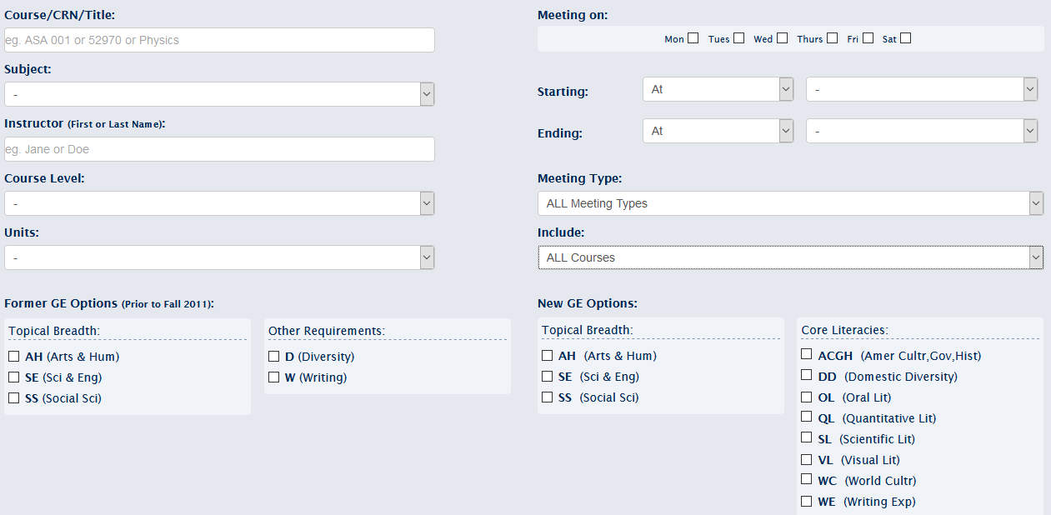
Advising Tools and Resources: Using Schedule Builder to Find GEs
https://my.ucdavis.edu/schedulebuilder
Notes:
The advanced option screen should like this. Take note of all the different filters (i.e. course level, include only open courses, and New GE Options—mainly Topical Breadth). When searching, please only search lower division, 0-99, courses.
Make sure everyone has gotten to this screen before moving onto the next slide/activity.

Slide 46
Schedule Builder GE Scavenger Hunt!
https://my.ucdavis.edu/schedulebuilder
1) When using the advanced search function, select “AH” under New GE Options section, followed by “001-099” under Course Level, and “3” for units. What is the first course that shows? Select “Show Details” What abbreviations do you see within the New GE Courses details?
2) When using the advanced search function, select “SS” under New GE Options section, followed by “001-099” under Course Level, and “4” for units. What is the first course that shows? Select “Show Details” What abbreviations do you see within the New GE Courses details?
3) When using the advanced search function, select “SS” AND “WC” under New GE Options section and “001-099” under Course Level. What is the last course that shows (you will need to scroll down)? Select “Show Details” What abbreviations do you see within the New GE Courses details?
Notes:
Continue to work in your pairs or triads to find the answers to these three questions. As soon as you have the answers to all three questions, raise your hands to share. If your team is correct, you may get a prize (CBS/BASC swag or candy?)
KEY:
CLA 010Y Greek, Roman, and Near Eastern Mythology; AH,VL,WC
AAS 010 African-American Culture and Society; DD,SS,ACGH,WE
WMS 020 Cultural Representations of Gender; AH,DD,SS,VL,WC,ACGH,WE
Remind students that they will need AH and SS units as CBS majors along with some core literacy units, but focus on AH and SS for today. Inform students of the double-dipping rule between Topical Breadth and Core Literacies; one course can satisfy one requirement in each large section of GE, but no more than one.

Slide 47
Advising Tools and Resources: Registration and Quarter Dates & Deadlines Calendar
https://registrar.ucdavis.edu/calendar
Important Fall 2019 Dates:
September 18 – October 10: Schedule Adjustment
October 8: 10th Day of Instruction (10 Day Drop Deadline and Late Fee Payment Deadline)
October 22: 20th Day of Instruction (20 Day Drop Deadline)
October 29: 25th Day of Instruction (Last day to opt to take a class P/NP—REMINDER: NO MAJOR COURSES CAN BE TAKEN P/NP)
Seek BASC Advising Assistance Early and Often!
Notes:
Please take note of some important fall dates that we don’t want you to miss. (Share each date and the importance of the date)

Slide 48
Questions?
We are here to help!
Notes:
What questions do you have so far? We are here to help!

Slide 49
Schedule Check-In
Do you have 15 units of planned courses for fall 2019?
This can include 0-2 major courses, GEs, and non-major courses
Are you confident about knowing how your placement scores impact your fall 2019 schedule?
Are you confident about knowing how AP/IB or transfer units impact your fall 2019 schedule?
If YES to all three questions, you are set to go!
If NO to any of the three questions, the next slide is for you!
Notes:
Before leaving today, please check the following (go through question by question on slide). Please also remember to bring your half-sheet to our group session tomorrow or take a picture!

Slide 50
OPTIONAL Advising for Today
15 min. Pre-Scheduled Appointments (1:20 – 4:30 pm)
If NO to any of the three previous questions, consider a brief 15 minute pre-scheduled appointment in BASC, 1023 Lab Sciences Building
Appointment Instructions:
Schedule a 15 minute appt. at https://cbsapps.ucdavis.edu/advising/Orientation
If you believe AP/IB/Transfer units will impact your fall schedule and need additional guidance on course planning for fall due to this
If you have community college coursework, please bring a copy of your unofficial transcript.
Reasons NOT to schedule an Appointment:
Confirm planned schedule is good for Fall 2019
Planning future quarters after Fall 2019 (we will discuss this during first-year mandatory advising)
Questions about minor(s), career exploration, health profession planning questions (we will discuss this during first-year mandatory advising)
If you have questions about changing your major to another college, you can go to their advising session this afternoon (except L&S)
Notes:
If you answered no to any of the three questions on the previous slide, you may want to consider a brief 15 minute advising appointment tomorrow morning during breakout sessions. (Review reasons a student might come in for one-on-one advising during Day 2 and reasons not to schedule a 15 minute appointment)
As a reminder, group advising from 3:30-5pm tomorrow afternoon is required. A 15 minute advising appointment is optional.

