Slide 1

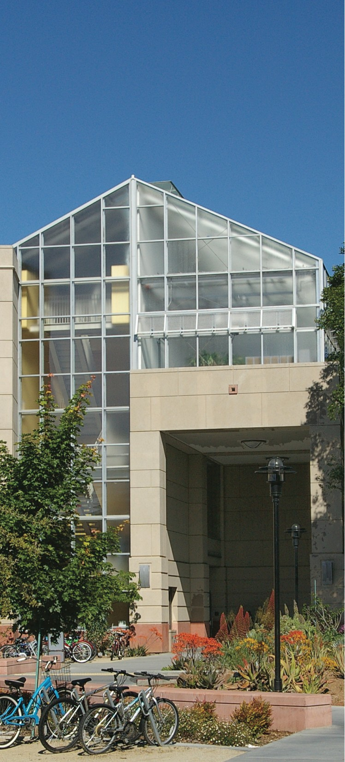

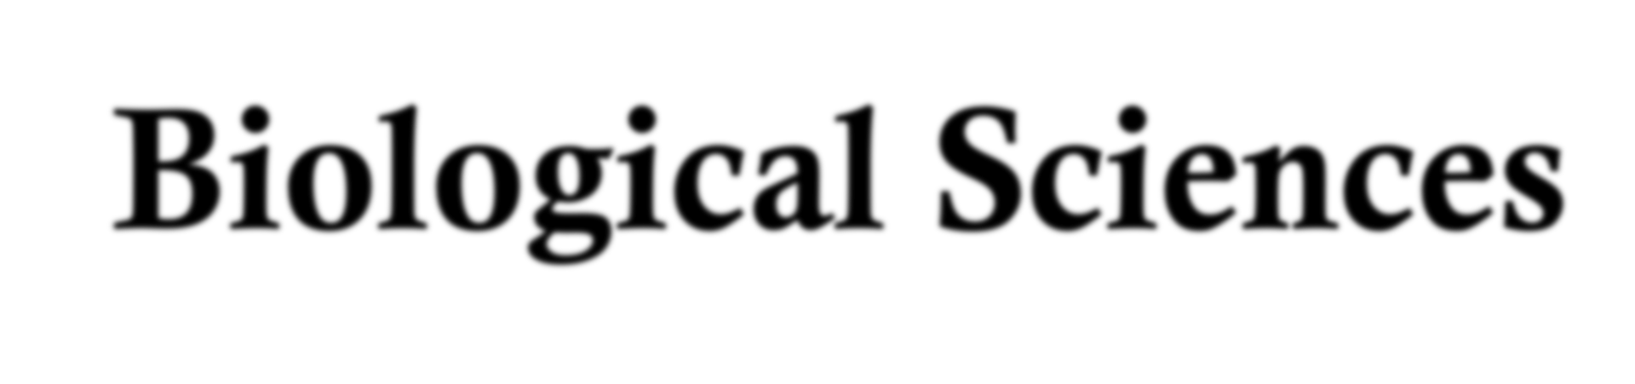
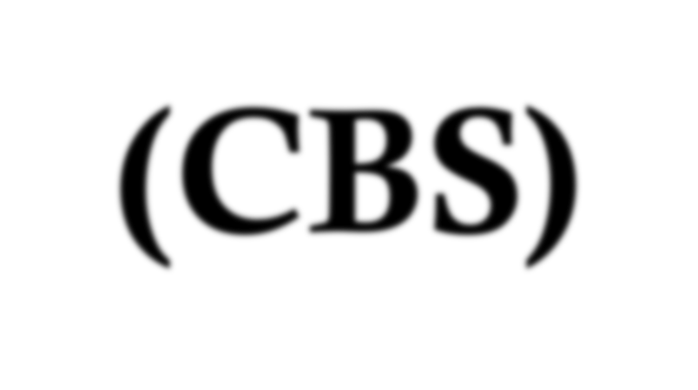




College of Biological Sciences (CBS)
First-Year Orientation
Your Associate Dean is Michele Igo cbsundergrads@ucdavis.edu

Slide 2
We know you worked hard to join CBS.
SUCCEEDING REQUIRES PASSION
Passion for the subjects you study will carry you through the difficulty of higher academics.
The “right” major is the one you gladly spend time studying.

Slide 3

CBS Majors
CBS Majors differ in what they ask questions about and in the way in which they ask questions.
Are you more interested in molecules, cells, organisms, or ecosystems?
Do you prefer “how” questions or “why” questions?
What sort of research problems do you find interesting?
Basically, you are choosing a model system for learning how to think. Therefore, you should choose a system that you find fascinating.

Slide 4
Special Note for students interested in one of the many Health Professions
All majors in CBS are considered “pre-med” and “pre- health profession” majors;
Medical schools are increasingly interested in students having a broad outlook;
  Therefore, select a major where you will succeed. One of our smaller majors such as Plant Biology & Evolution or Ecology and Biodiversity may be ideal choices for you;
Medical schools are increasingly interested in students having a broad outlook;
  You might also consider getting a BA rather than BS degree
Health Profession Advising would be a great place to discuss your options.

Slide 5
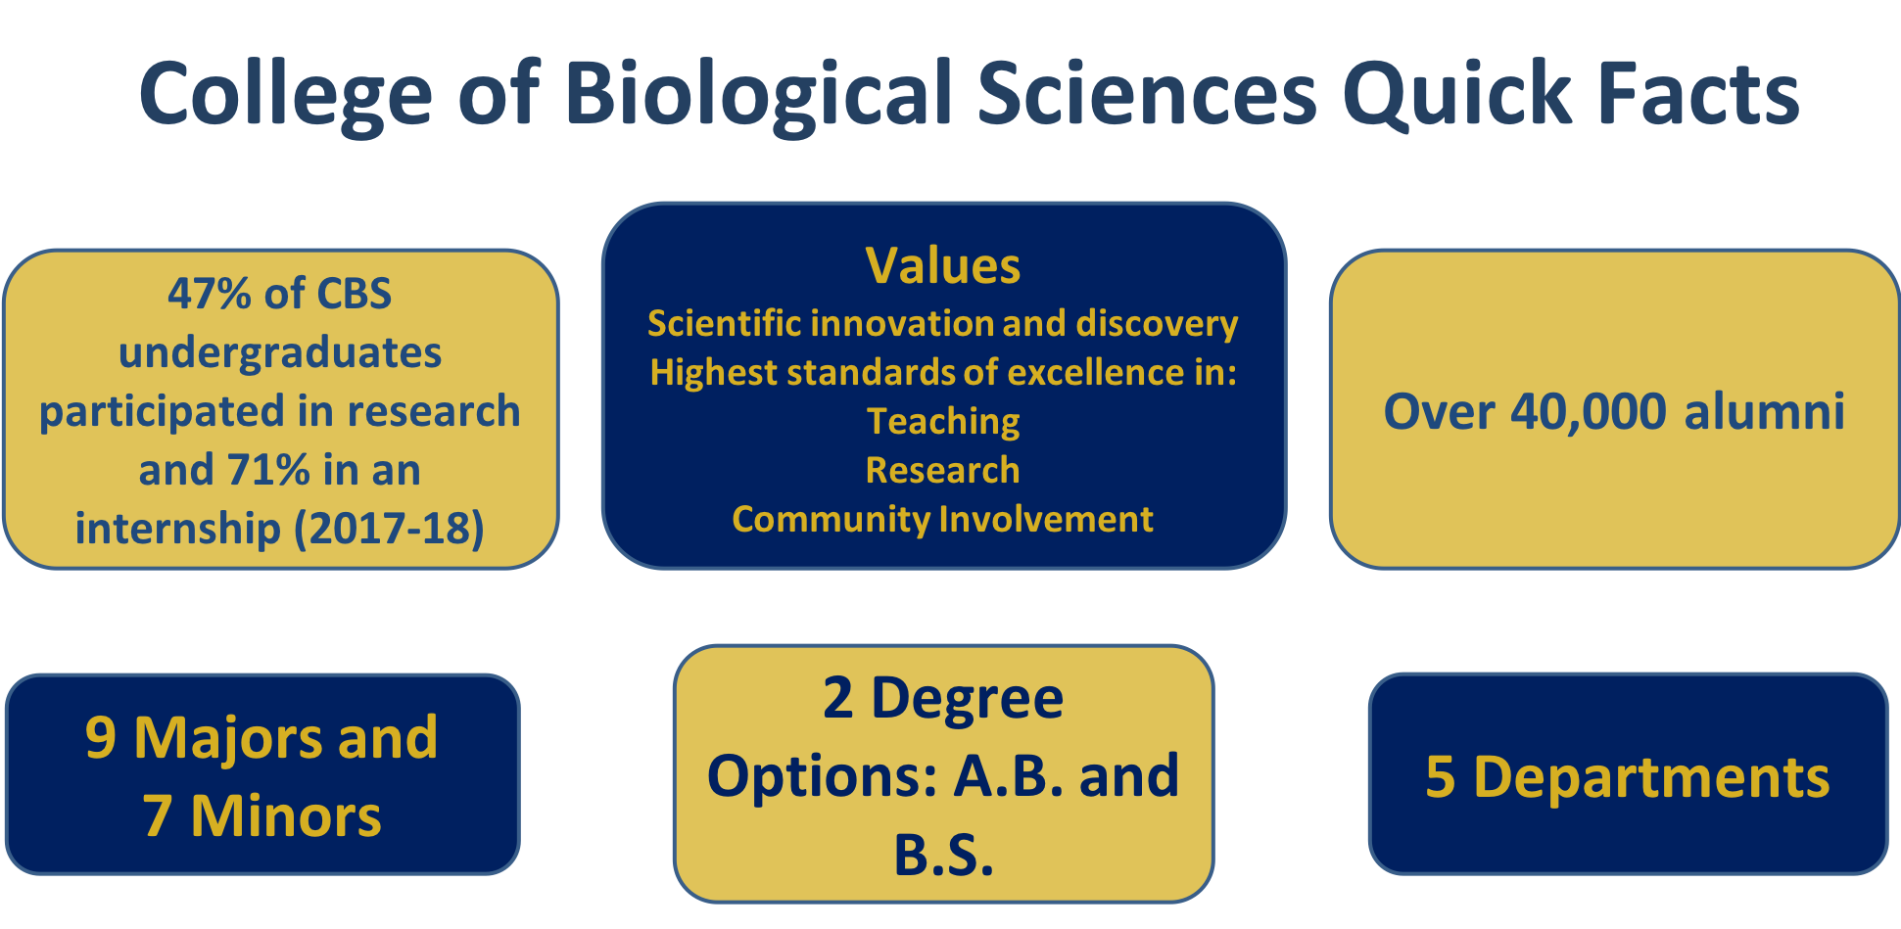

Slide 6
CBS has 9 majors for a BS degree and 4 for a BA*
 | Majors
EVE | Evolution, Ecology and Biodiversity (EEB) BS or B
MCB | Biochemistry and Molecular Biology (BMB) Cell Biology (CBI) Genetics and Genomics (GGN)
MMG | Microbiology (MIC) BS or BA
NPB | Neurobiology Physiology and Behavior (NPB)
PLB | Plant Biology (PLB) BS or BA
 | Biological Sciences (BIS) BS or BA
 | Marine and Coastal Sciences (MCS) is a CROSS-COLLEGE major where CBS hosts one track called Marine Ecology and Organismal Biology
*The B.A. has a foreign language requirement, the B.S. does not.

Slide 7
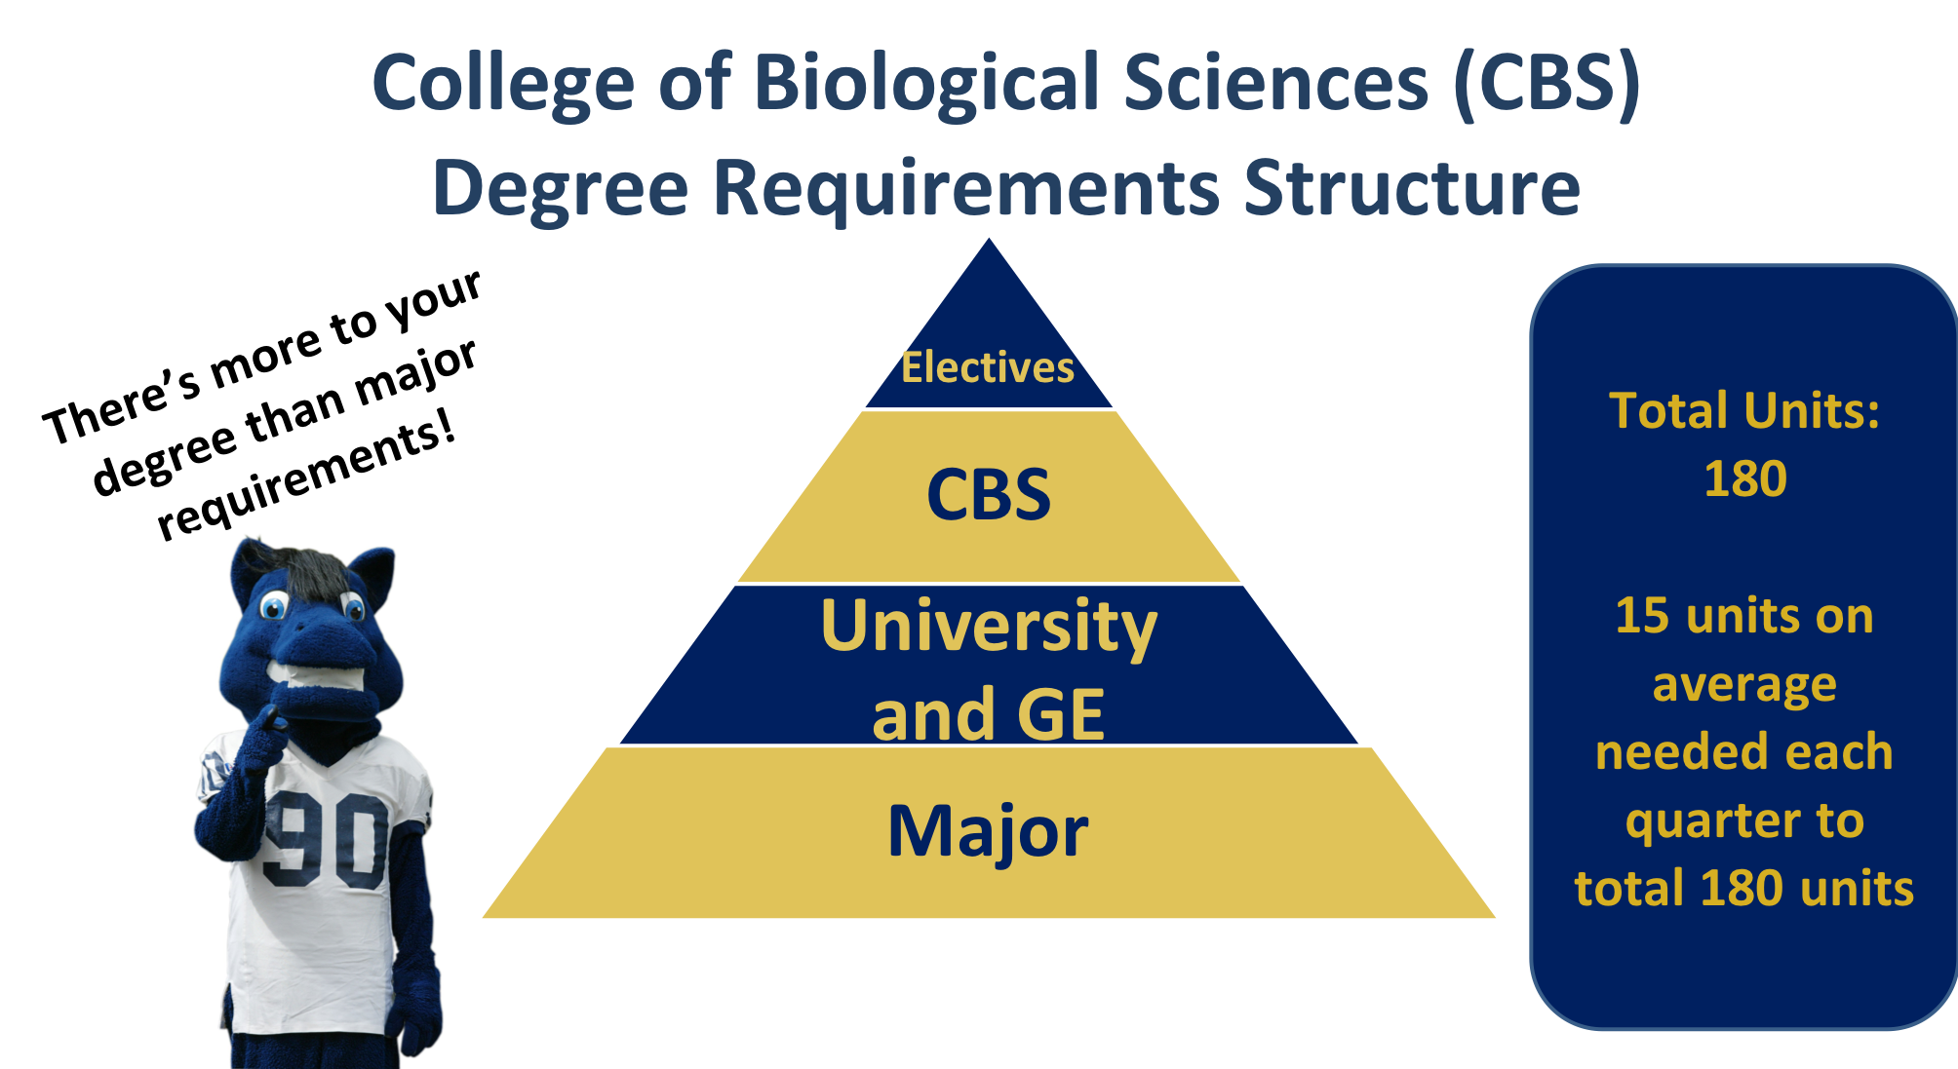
How do I figure out what courses to take? Talk to your BASC advisor.

Slide 8
Lower Division CBS STEM Core
Freshmen/Sophomores
´Biological Sciences (BIS) 2A, 2B, 2C
´Chemistry (CHE) 2A, 2B, 2C
´Mathematics (MAT) 17A, 17B, 17C or
(MAT) 21A, 21B,
´Physics (PHY) 7A, 7B, 7C
You should plan to:
complete these requirements by the end of your sophomore year. (~2 STEM/quarter).
take an average of 15 units every quarter.

Slide 9
Lower division curriculum notes: What courses should I start with?
´ The answer depends on your placement exam scores.
TRUST THE PLACEMENT TESTS!
´ The placement exams are designed to make sure that you do well in your first classes in Chemistry, English, and Math at UC Davis.
´ These are foundational classes and you need this knowledge to be successful.
´ Therefore, if your advisor recommends workload classes in a specific discipline, take this extra prep.

Slide 10
Lower division curriculum notes: What courses should I start with?
The answer depends on your major and your placement exam scores. It also depends on the availability of seats in a particular class.
DON’T WORRY! Your BASC advisor will help you create a schedule that will keep you on track.
Special Note about Math
  All majors in CBS require Math 17 ABC
  Math 21 is a good alternative for students interested in more advanced math or the physical sciences (bioinformatics,computer science, biophysics, structural biology, engineering).
  Caution! Math 21 is NOT a good alternative for most students if Math 17 is full.

Slide 11
Lower division curriculum notes: What courses should I start with?
SUGGESTED STEM COURSES BY MAJOR.
Students in BMB, CBI, GGN, NPM & ULS majors:
´Take Mathematics and Chemistry in their your quarter, and add a 3rd science class (add Biology 2) by the end of the first year (winter or spring). Start Physics in Sophomore year.
Students in BIS, EEB, MCS, MIC, & PLB majors:
´Take Biology and Chemistry in your first quarter, and add a 3rd science class (Math) by the end of the first year. Start Physics in Sophomore year.
Another option for any CBS major:
´Take Mathematics and Biology in your first quarter, and add a 3rd science class (add Chemistry 2) by the end of the first year (winter or spring). Start Physics in your sophomore year.

Slide 12
Lower division curriculum notes: Which BIS 2 course is first in the series?
´ It depends on you and your interests. Neither BIS 2A nor BIS 2B has a prerequisite.
´ Starting with BIS 2B will be a good plan for many students.
´ You take BIS 2B, then BIS 2C, and finish with BIS 2A as a good lead- in to BIS 101.
´ Starting with BIS 2A only works for “CHE 2A ready” students.
´ Students will need a good high school chemistry class to know the chemistry required in BIS2A.
´ Do you understand the difference between carbon and oxygen? What is the difference between a covalent bond and a hydrogen bond? What does pH mean? What is an electron? By lecture 5, can they recognize a molecule as a protein, a lipid, a sugar, or a nucleic acid after we have explained the distinguishing features of these molecules?

Slide 13
Fall 2019 Scheduling Preparation: What types of courses should I take?
PLAN A
Major Course Major Course GE
If ELWR is not satisfied, ELWR course; If satisfied, Lower Division Composition or GE
BIS 5 or First Year Seminar
APPROX. UNITS: 15
PLAN B
Major Course GE
GE
If ELWR is not satisfied, ELWR course; If satisfied, Lower Division Composition or GE
BIS 5 or First Year Seminar
APPROX. UNITS: 15
PLAN C
GE GE
GE
If ELWR is not satisfied, ELWR course; If satisfied, Lower Division Composition or GE
Non-Major or GE BIS 5 or First Year Seminar
APPROX. UNITS: 15
General Education Classes: CBS students are encourage to select their GE classes based on interest and should sample broadly. There are many good choices, including music, dance, art history, languages, and studies of other cultures. What should the person you want to become know about?

Slide 14
You can also select your general education courses based on your future career goals.
´ Many CBS students interested in the health care professions have found the following classes helpful.
´ Classics 30 explains the Greek and Latin roots of language and incorporates a lot of biological terms.
´ Philosophy 31 introduces students to scientific reasoning and analysis, useful for exams such as the MCAT (other good choices are PHI 5 or 12).
´ History 2/STS 2 is “Introduction to the History of Science and Technology.” The course has a strong critical reasoning component, useful for exams such as the MCAT.
´ Philosophy 15 introduces students to Bioethics.

Slide 15
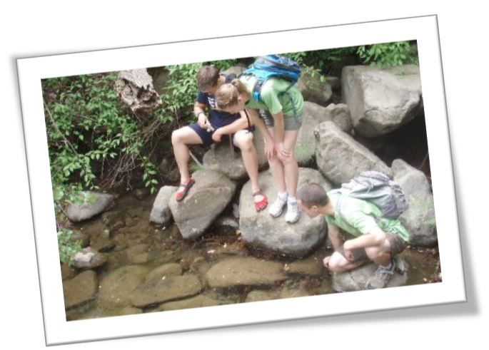
Evolution, Ecology &
Biodiversity (EEB)
Broad and balanced exposure to biology
Understanding the diversity and distribution of living organisms
Application of ecology and evolution to all life sciences, including disease
Darwinian Medicine class
Understanding global biodiversity– from the evolution of
genomes to the behavior of species and the functioning of
communities across the Tree of Life

Slide 16
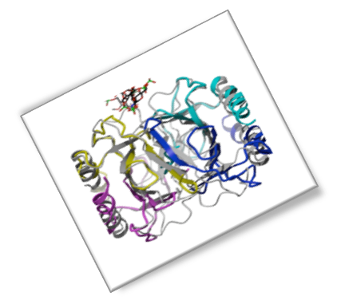
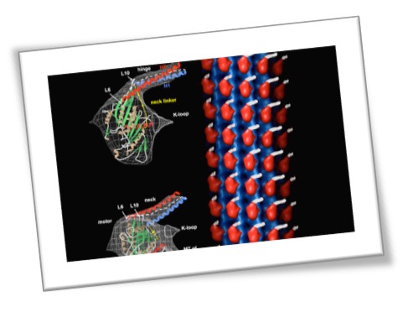
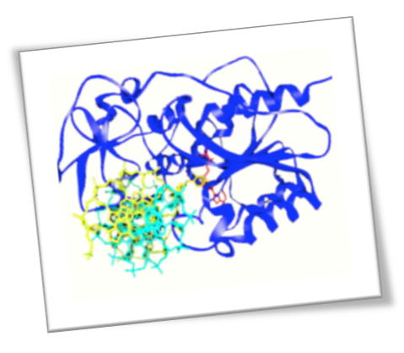
Biochemistry and Molecular
Biology (BMB)
u Introduces students to the chemistry of living organisms
u Training in the experimental techniques that are used to probe the structures and functions of biologically important molecules
u Students who enjoy both chemistry and biology and who are comfortable with quantitative approaches to problem solving will find this major a rewarding field of study

Slide 17
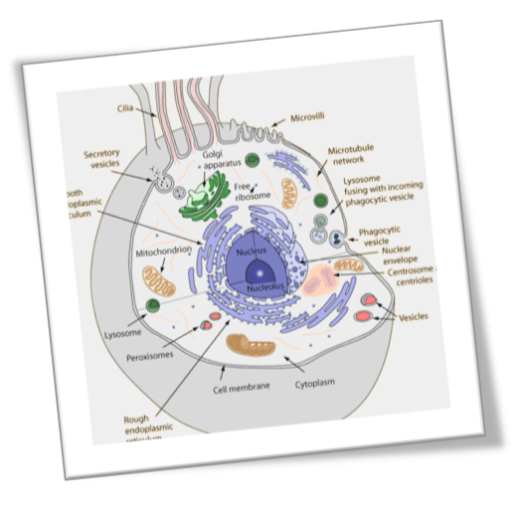
Cell Biology (CBI)
All complex biological phenomena have their root in
mechanisms that operate at the cellular level
Studies in cell biology ask questions such as:
How does a cell divide and communicate with other cells?
Why do some cells become cancers?
How do cells age and die?
What are stem cells and what are their magical properties?
How do cells become infected with viruses e.g. HIV?

Slide 18
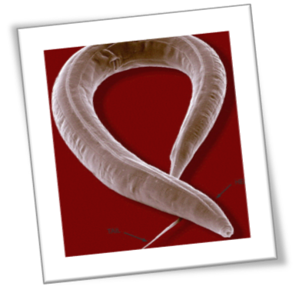
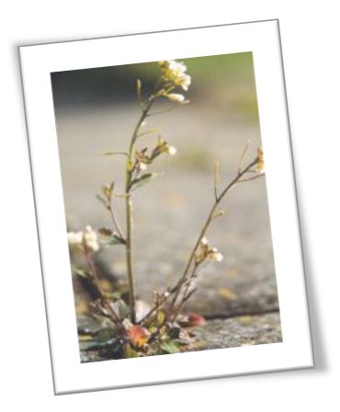
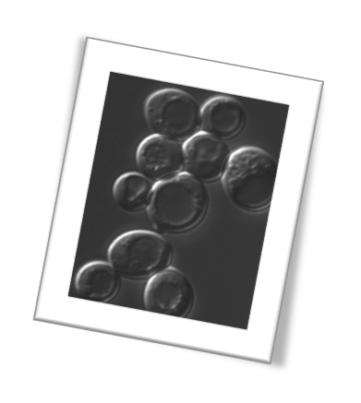
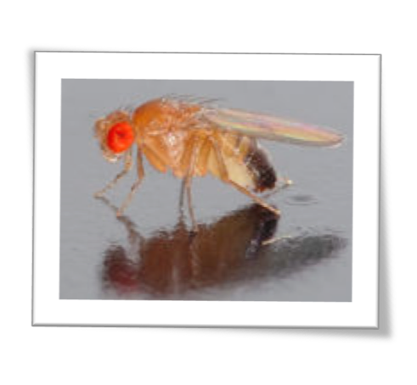
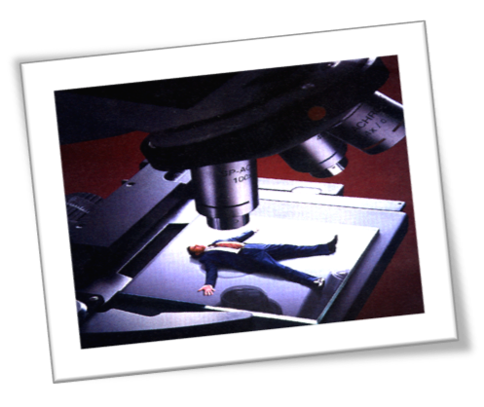
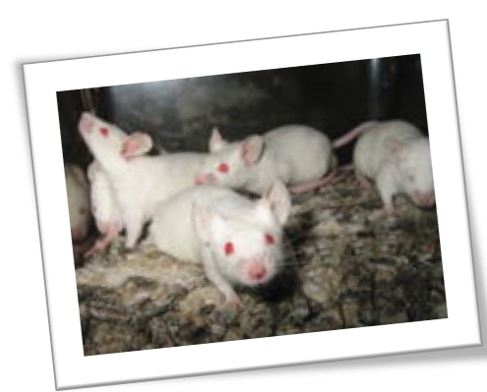
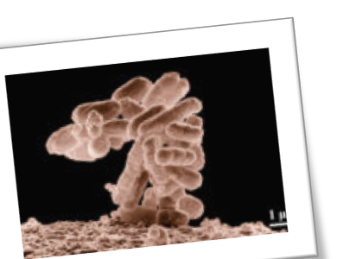
Genetics and Genomics (GGN)
C. elegans
A. thalia
a
Study of genes, hereditary, and variation in a
wide range of model systems
S. cerevisia
H. sapiens
D. melanogaster
M. muscu us
E. coli

Slide 19
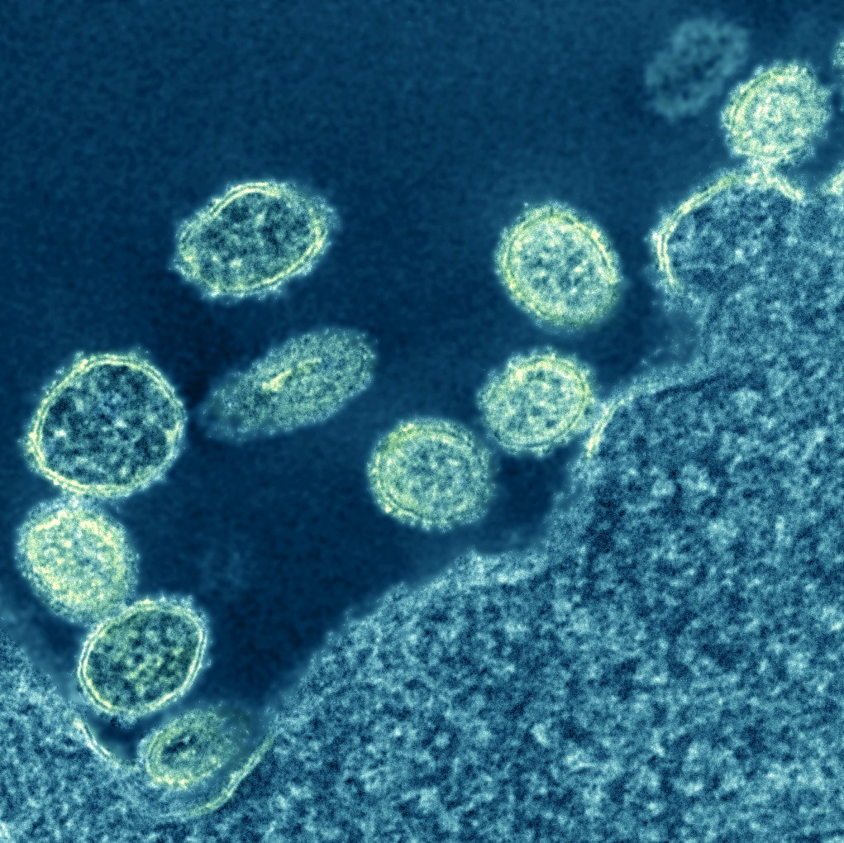
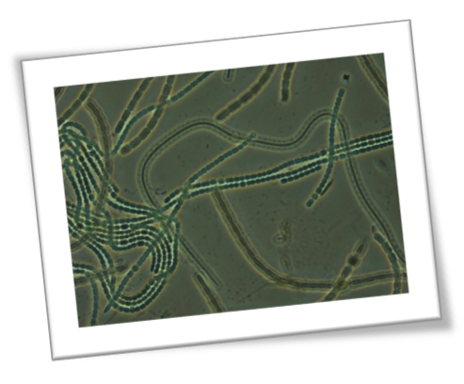
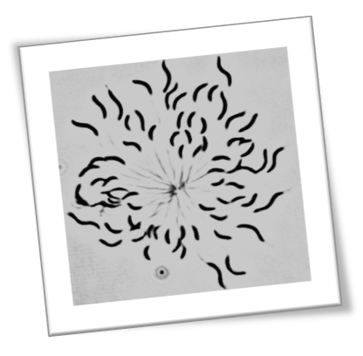
Microbiology (MIC)
Microbes are the most abundant (and ancient)
organisms on earth -
many are pathogens....but most are not
Microbiology majors learn about the microbial world and the interactions of microbes and their environment.
Microbiology is great training for medical fields since many diseases are caused by microorganisms.

Slide 20
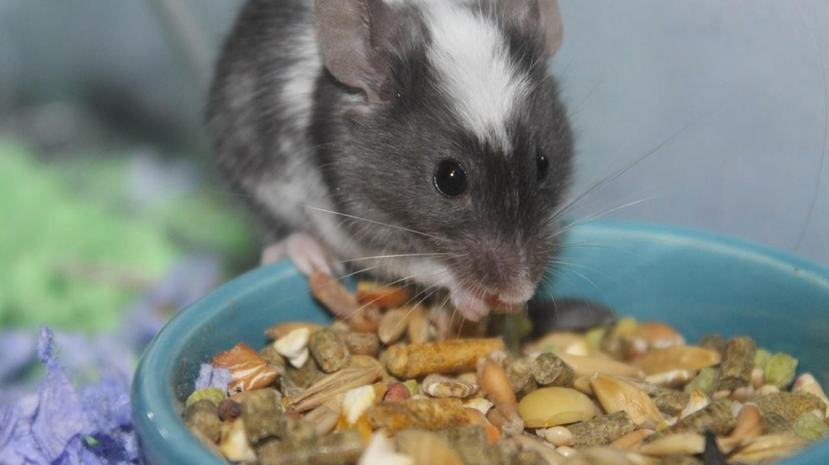
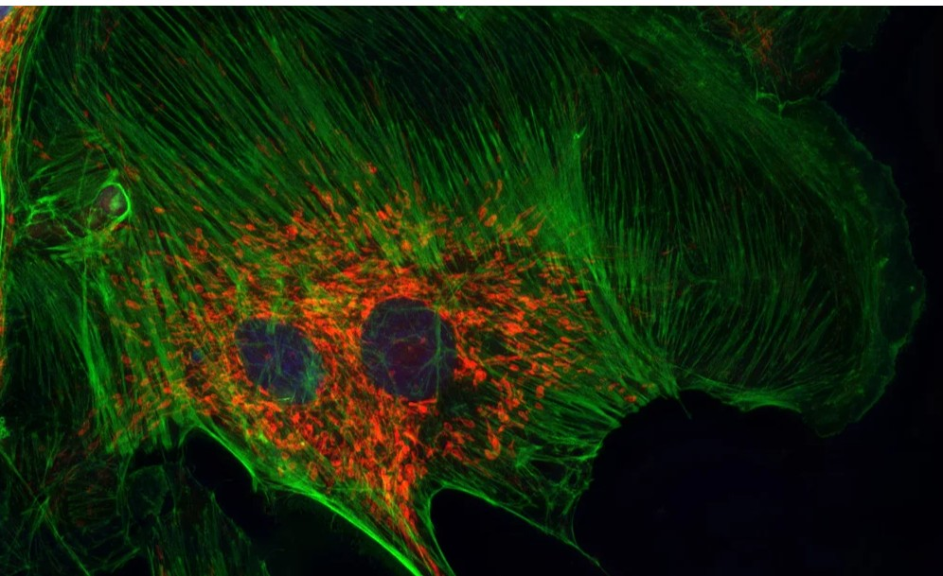
Neurobiology, Physiology & Behavior (NPB)
Understand vital functions common to all animals
Students in this major will study functional mechanisms, as well as the control, regulation, integration, and behavior that relate to these mechanisms at the level of the cell, organ system, and organism.

Slide 21
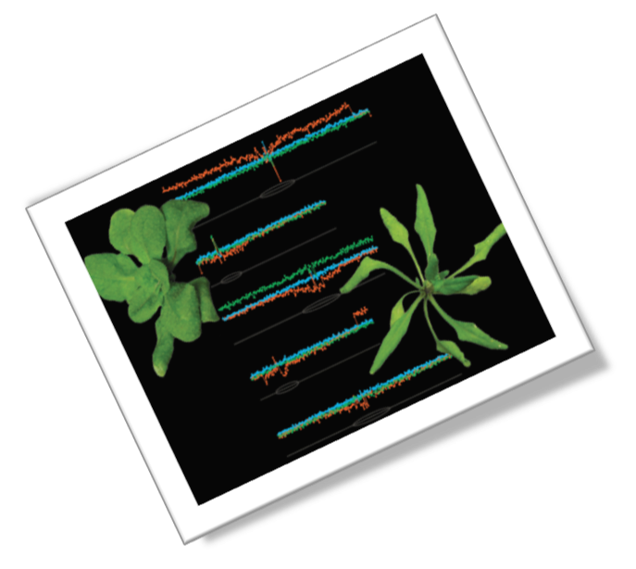
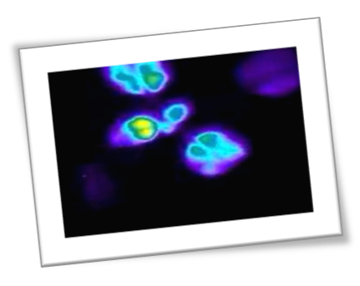
Learn how the internal timer/circadian clock allows plants and humans to regulate their physiology.
Plant Biology (PLB)
Plants influence all aspects of life on earth.
Revealing organismal differences by analyzing DNA sequences, chromosomes, and gene expression!
Guaranteed research opportunities
Hands-on experience in modern life science research
Designated scholarships
Contributions to human health and environmental stewardship

Slide 22

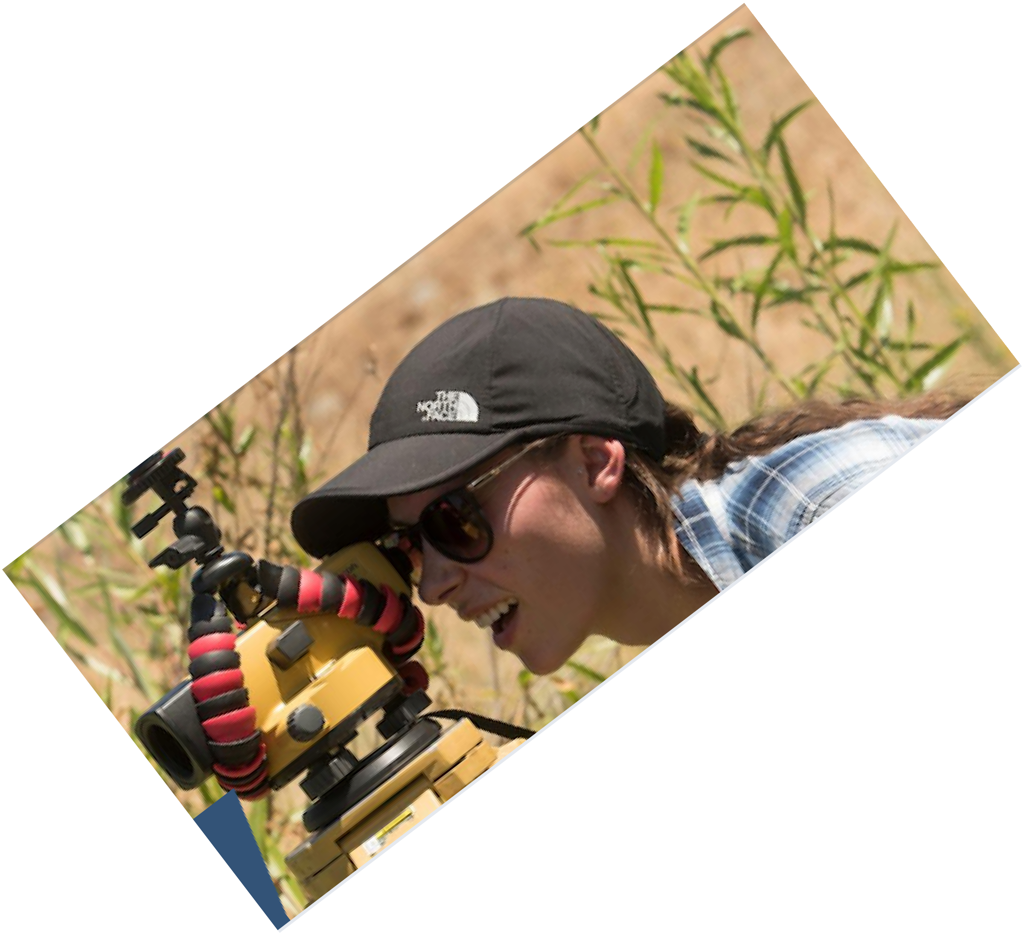



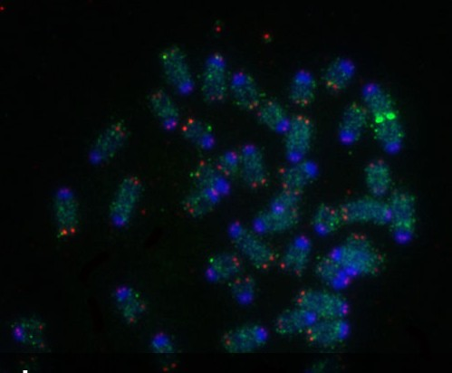
Biology is a good foundation for any career, so don’t’ forget about environmental law or science writing, in addition to more traditional paths.
Biological Sciences (BIS)
.
This is our broad cross-college
major
BIS Major:
Students complete a broad set of preparatory courses and select one or more areas to focus on for their upper division specialization.

Slide 23
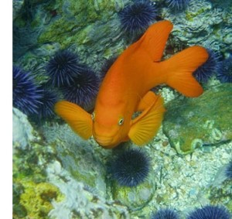
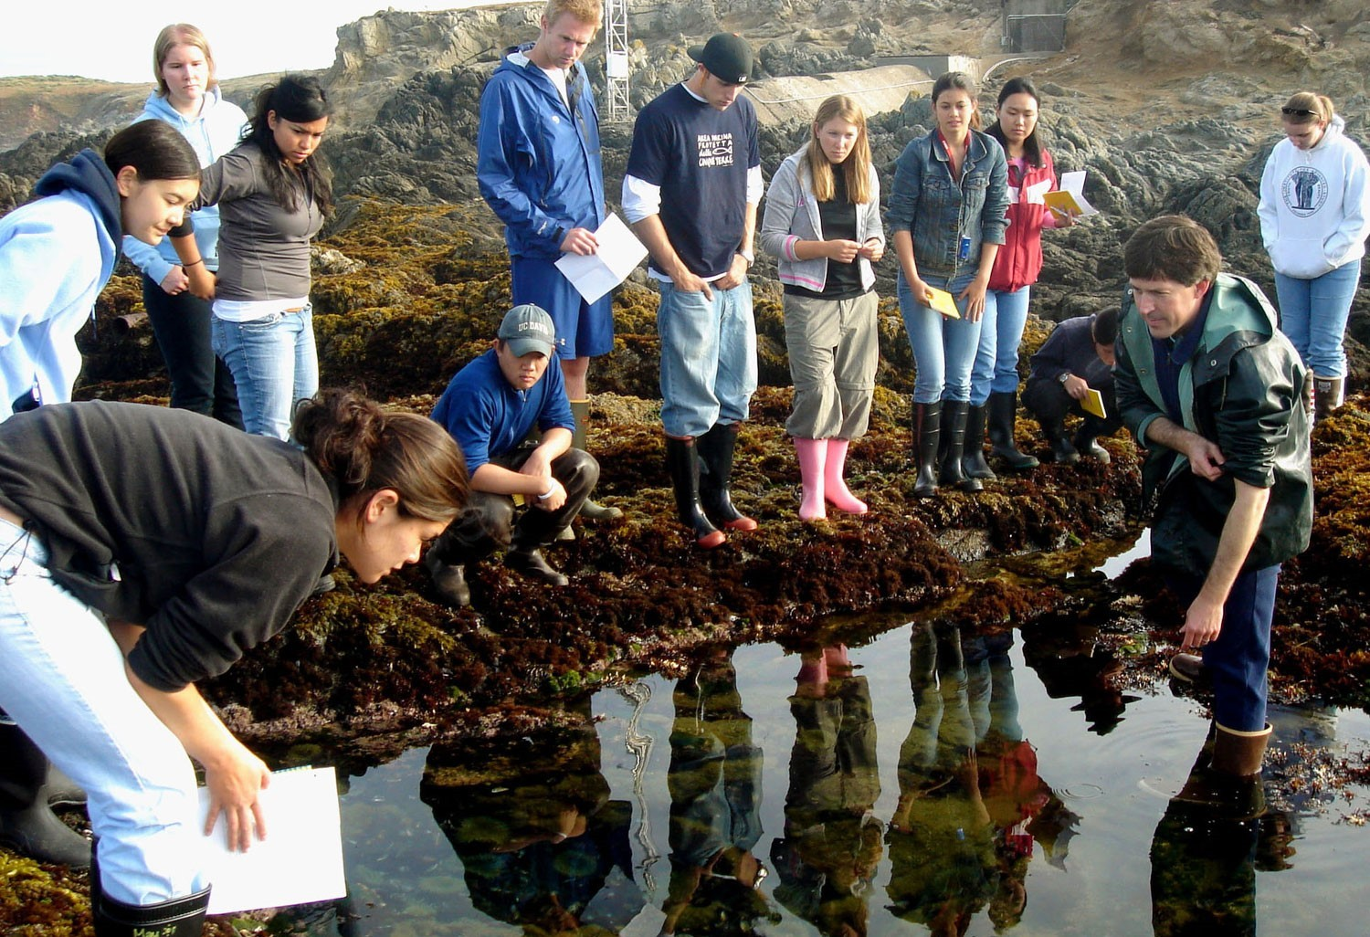
Study the ecology and organismal biology of the marine environment. Delve into the physiological adaptations of organisms and the biology of marine species from the molecular to population levels.
Marine and Coastal Sciences (MCS)
marine ecology and organismal biology track
Field work is a key component of this track.

Slide 24
SUCCEEDING REQUIRES PASSION
Take the time to explore the different CBS majors
“Don't ask yourself what the world needs. Ask yourself what makes you come alive and then go do that. Because what the world needs is people who have come alive.”
- Dr. Howard Thurman

Slide 25
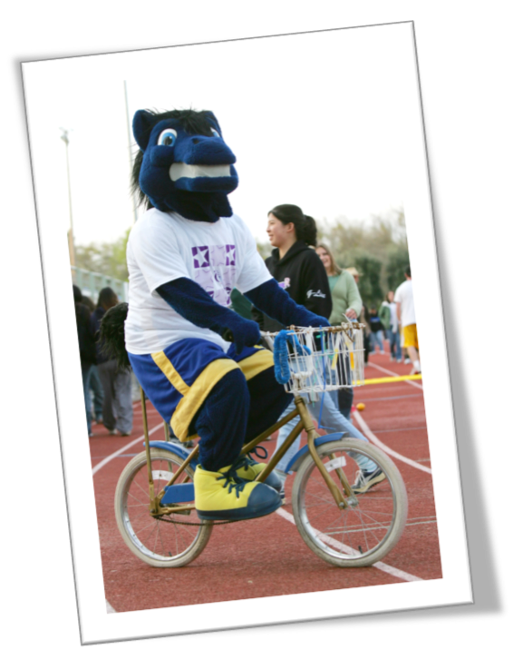
Next up: Students resources to help you with the transition to UCD
https://www.davisenterprise.com/files/2014/02/gunrock-bikeW.jpg

Slide 26


Students often notice:
Students often notice:
• The classes are much larger than expected (hard to make friends).
• The material is challenging (13-15 units is plenty).
• You should expect to analyze, not memorize.
• Students are responsible for seeking help.
• You need to find the course materials on the Canvas site
• The quarter system moves quickly.
• Organization is extremely important.
• A lot of time should be devoted to studying.
The classes are much larger than expected (hard to make friends).
The material is challenging; 2 STEM classes is plenty
You should expect to analyze, not memorize.
Students are responsible for seeking help.
You need to find the course materials on the Canvas site
The quarter system moves quickly.
Organization is extremely important.
A lot of time should be devoted to studying.
The material is challenging (13-15 units is plenty).

Slide 27
To get a good start, create and rely on a weekly planner.
´To manage your time, consider the Carnegie rule—a student should spend at least two hours working outside class for every hour in class.
´•For 15 units, this means 15-20 hours in class (labs) and 30 hours outside class studying.
´•This means you should expect a 45-50 hour work week on school alone!!
´A GPA above 2.0 is required for good standing ; C- is not above 2.0

Slide 28


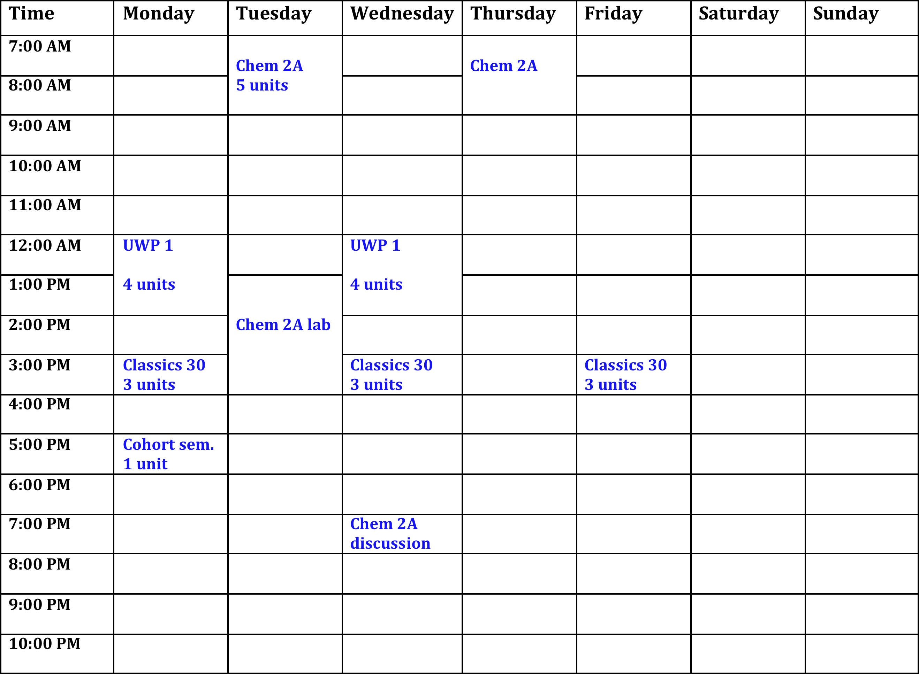
Fill in the planner with 15-20 hours in class.
Add 30 hours
per week of high quality study time
Fill in your extra- curricular activities.
Is your plan is realistic?
Delayed gratification now may ensure future success.

Slide 29
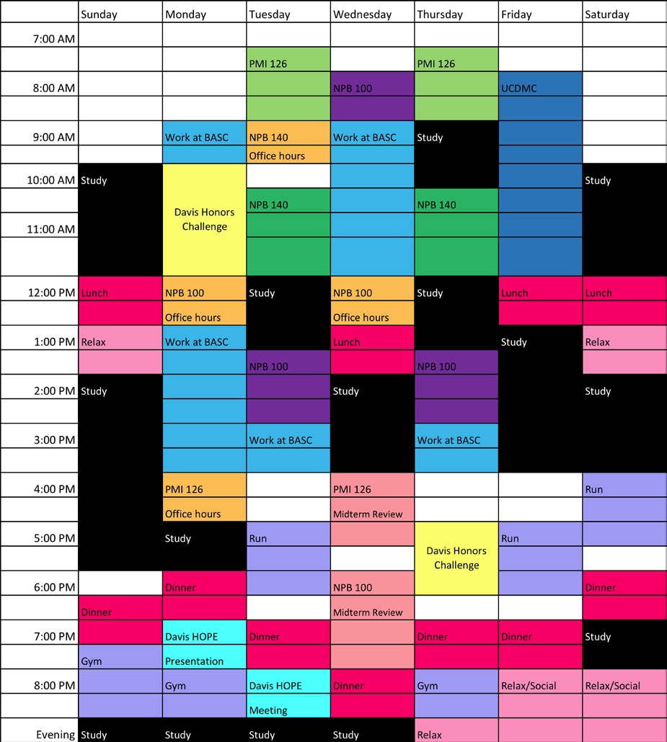
Time management from a successful student

Slide 30
What should I do during my study hours?
Identify your learning goals
Review your notes after each lecture while listening to the podcast and looking at the lecture slide PDFs. Fix your notes – you hear more the second time around and you will be prepared for the next class.
Mark the places where you are confused.
Once you know what you don’t know, you can find out additional information via the textbook, office hours, or other resources.
Start with your textbook and study questions or lecture guides.
  Textbooks aren’t novels – you need a reading plan.
  Read the chapter to confirm your knowledge of a topic.
  Abstract the chapter via headings, main points, and examples.
  Interrogate the book.
Be able to explain material without your notes.
PUT TIME INTO YOUR FUTURE BY KEEPING UP WITH EACH CLASS

Slide 31
Some professors provide useful learning goals
Lecture 14. More on Genetics
- How are the laws of probability applied to offspring formation?
- How does the genotype influence the phenotype?
Students should be able to:
§explain Mendel’s two laws
§predict the frequencies of particular offspring genotypes and phenotypes given parental genotypes
§diagram a test cross and explain possible outcomes
§explain the roles of multiple alleles, pleiotropy, and epistasis in determining the phenotype
§differentiate linked and unlinked genes and explain how crossing over
affects linked genes
§explain the genetic basis of polygenic traits

Slide 32
What if I don’t do well on multiple choice exams?
Don’t Worry: It ‘s a skill you can learn!
If the wrong answers confuse you, then cover all the answers, read the question, and decide what the answer is. Look for only that answer in the list of choices.
If your exam score is not what you wanted, analyze your exam by asking why you got each question wrong.
If you did not know the material, then study more, but if you skim the questions or don’t understand the questions, studying more will not help—read the questions slowly or seek confirmation of the question from the TA.
Analyze your performance!

Slide 33
YOUR SCORE ON AN EXAM IS FEEDBACK – REFLECT ON IT.
Always check your exam scores and then go over the exam.
Start with the assumption that if you did not answer correctly, you do not understand the topic.
Do not assume that the question is “odd” or “poorly written;” find out what you do not understand before the next exam.
Find a study group
Practice talking about the material and explaining it.
  This is an important skill for most professions. Study groups help you become a better speaker and listener.
  The only real test is a blank piece of paper; if you truly understand, you can answer any exam question

Slide 34
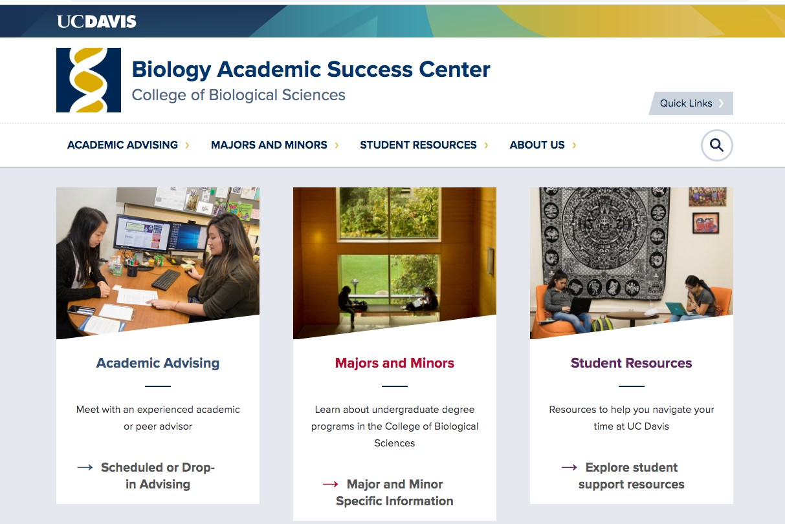
BASC is your best resource for success in CBS

Slide 35
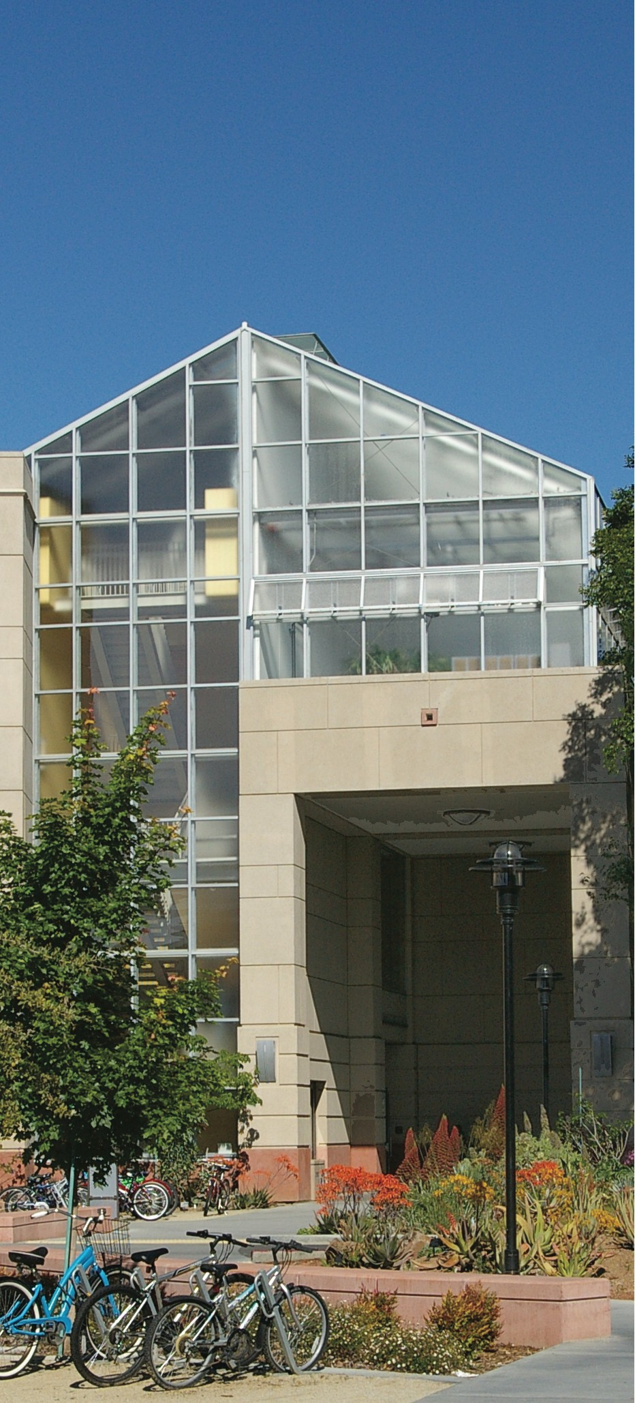
There is one location for CBS advising: BASC
All staff and peer advising takes place in the Biology Academic Success Center (BASC) in Sciences Lab Building, around the corner from the BioBrew Coffee Shop.
Students are called to mandatory advising in the fall/winter.
Faculty Master Advisors are associated with each major and can be visited in their departments.

Slide 36
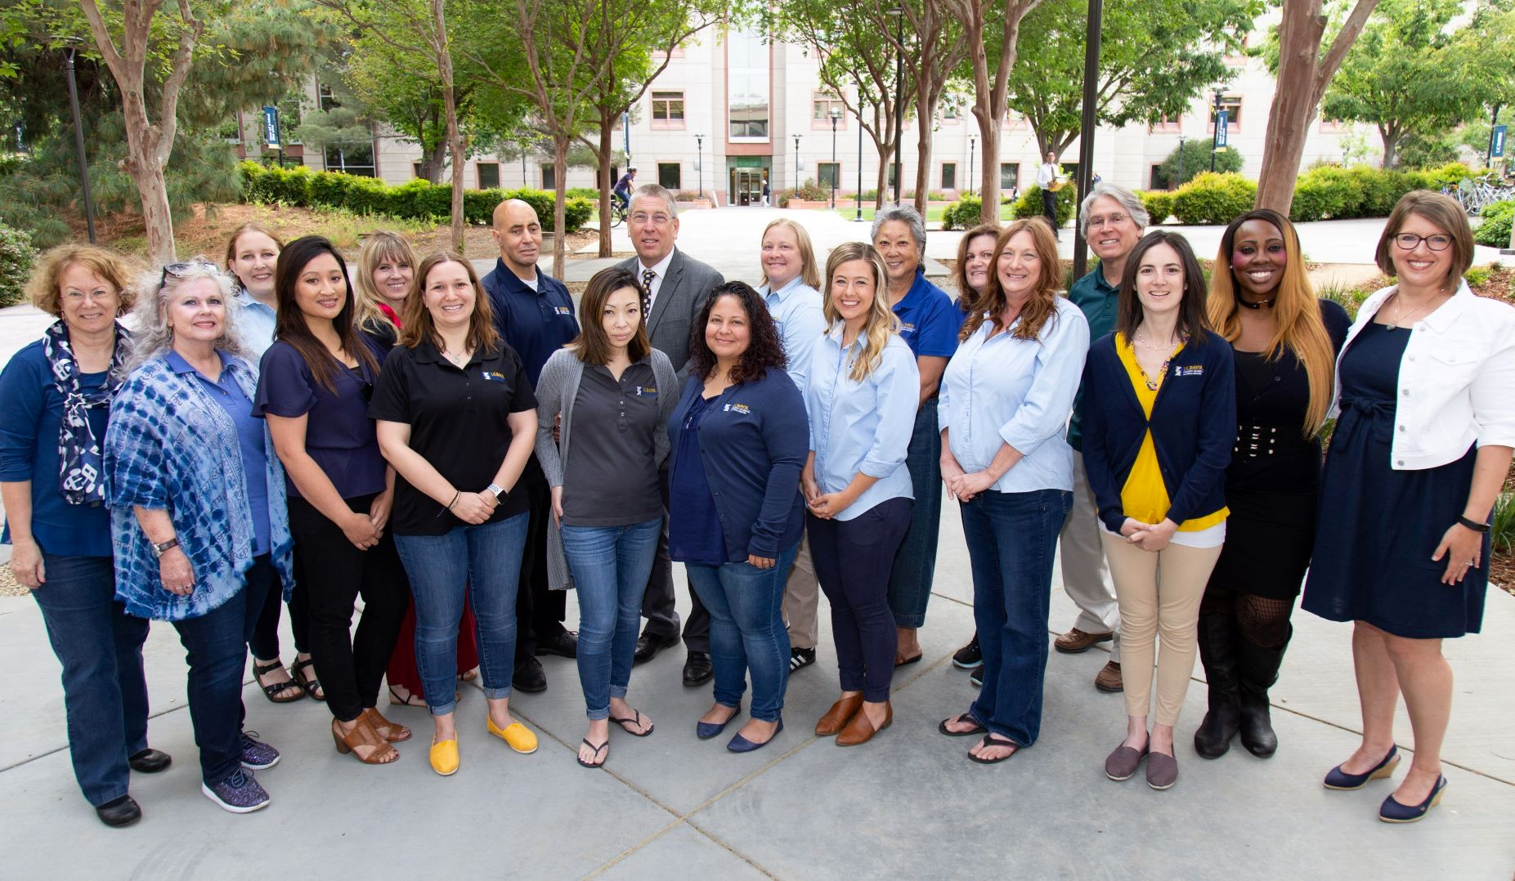
A BASC advisor will help you structure a schedule that works for you and your goals

Slide 37
How can advising help me?
Staff advisors at BASC help you in many ways:
Check in with you and your transition during Mandatory Advising
Provide academic advice on particular majors:
  Assist you in making an academic plan and choosing courses
  Give advice on changing majors
  Help you maintain progress toward degrees and GE
Support you through any academic difficulties:
  Leave of absence from school
  Student petitions
  Special situations
  Referrals to other campus services
NOTE: Come to the BASC as soon as something is taking a turn in the wrong direction.
Peer advisors are available on a drop-in basis anytime the BASC is open; peer advisors are fellow students have shared your experiences.

Slide 38
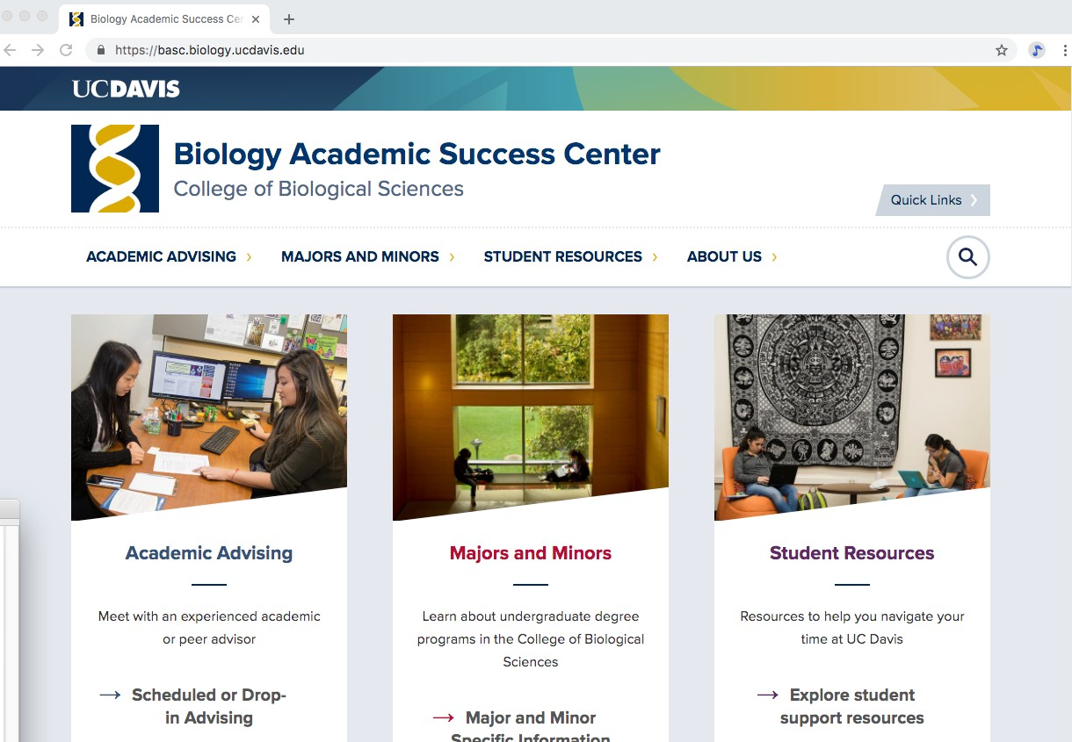
Check out the BASC website for more information on their many programs

Slide 39
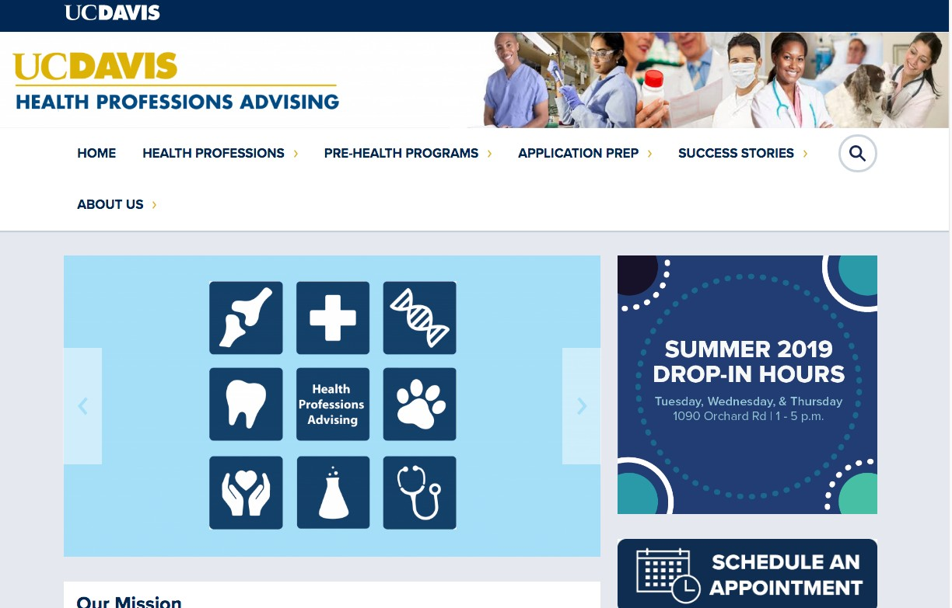
Health Professions Advising
Check out the website: hpa.ucdavis.edu

Slide 40

Upcoming Event at HPA

Slide 41

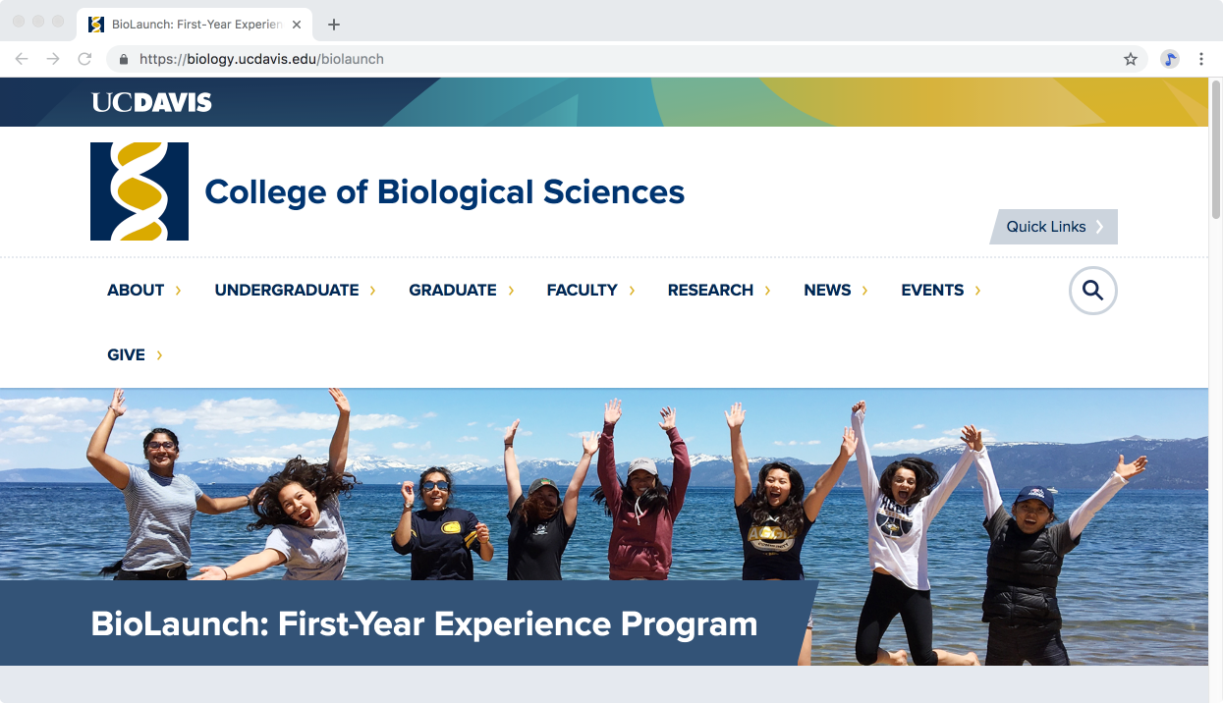

Slide 42

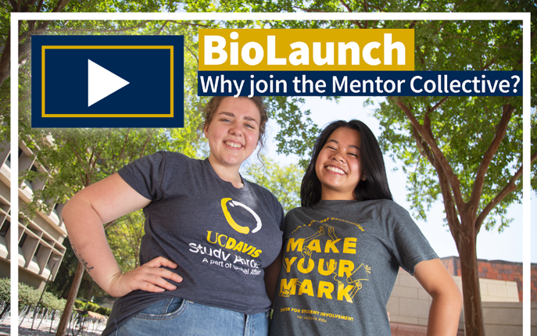
Launch Mentor Collective
How does it work?
You should have received an email from me providing you with a registration link.
Once you are registered, you will be asked to complete a survey asking about your background, interests, and what you are looking for in a mentor .
Based on your answers, you will be connected with a CBS students, who has volunteered to help you learn the ropes
at UC Davis.

Slide 43
BIS 005: Exploring Biological Sciences (1) P/NP
´ Lecture/Discussion class– 1 hour. This course provides students with perspective on CBS and the resources and opportunities that are available at a major research university like UC Davis.
´ The instructor is Dr. Michele Igo, who is the Associate Dean of the College of Biological Sciences. She will be inviting faculty, researchers, representatives from different campus resources, and other people on campus to talk about the unique opportunities available at UCD.

Slide 44
INCOMING STUDENTS CBS FALL WELCOME
´ Monday, September 23, 2019: 1:00 - 2:30 p.m.
Life Sciences Building-605 Hutchison Drive
Dean’s Welcome at 1:30 PM
Desserts and drinks provided.
  This event takes place just before the Chancellor’s New Student Celebration at the UC Davis Pavilion.
´ Pick up your BioLaunch T-Shirt
´ Meet your BioLaunch peers.
´ Talk to faculty, post-docs, graduate students, and undergraduates about research opportunities on campus

Slide 45
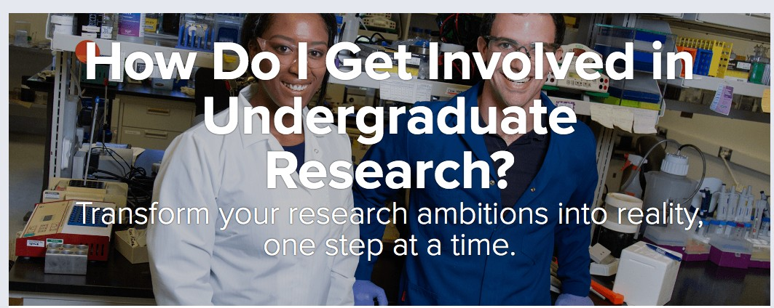
https://biology.ucdavis.edu/undergraduate- research

Slide 46



Research and Internship Opportunities
Research is fun and you can highlight your ability to apply knowledge on your resume.
The current faculty count in the College of Biological Sciences is about 130.
There are about 700 biologists on campus. They offer a wide range of research opportunities all available to you.
47% of our undergraduates have worked in a research lab.
71% have held an internship before they graduate.
Some students join the author team on a published paper.
Rewards: Taste of the field; letter of recommendation(s); expanded skills & contacts.
Risks: Time away from studying; balance and time management may be more difficult.

Slide 47





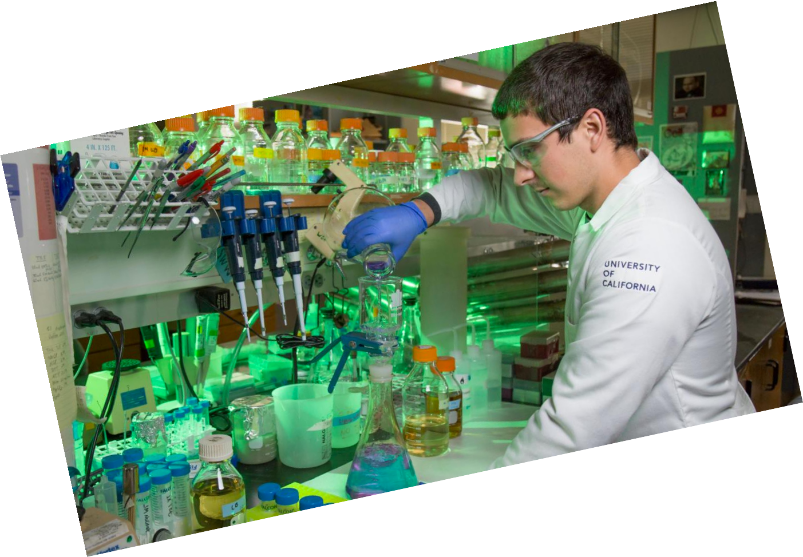

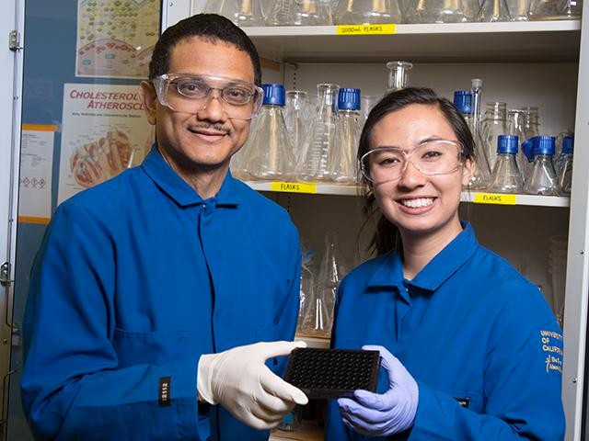




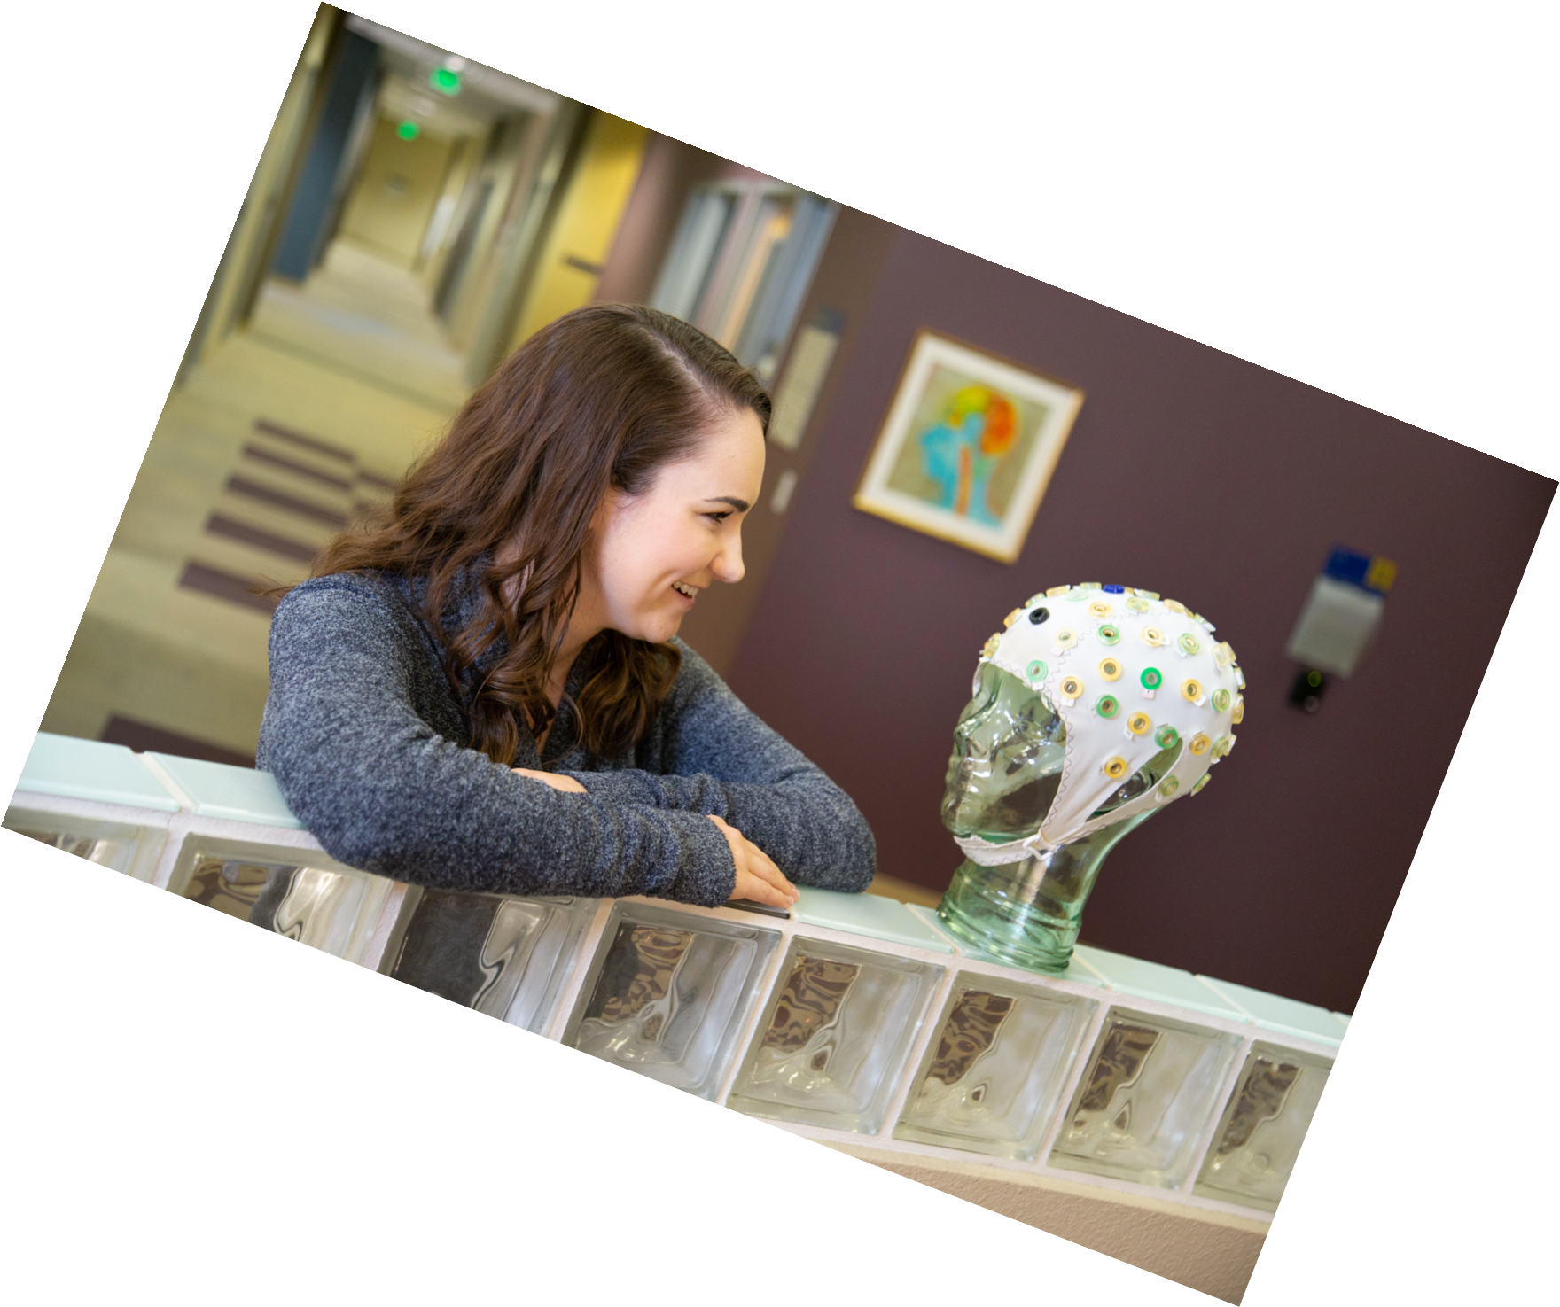



Research and Internships
Speak with your BASC advisor
Talk to your faculty adviser or other faculty
Do well in a faculty member’s class
Visit the Internship and Career Center (ICC)
Visit the Undergraduate Research Center (URC)
Be active and informed in contacting faculty
You can get research (PUF) and travel grants

Slide 48

Check out CBS courses and various internships at Study Abroad

Slide 49
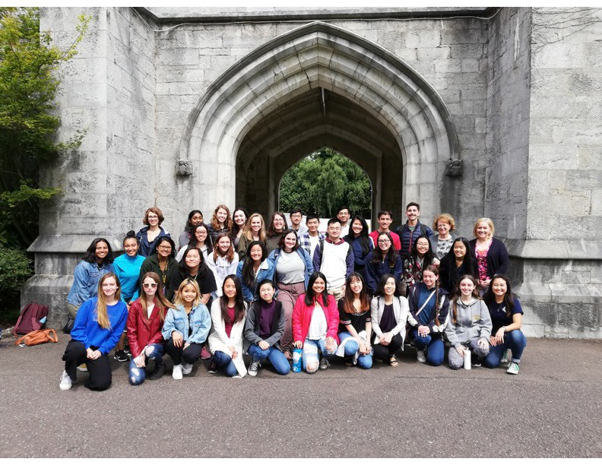
BIS2 courses are now offered abroad in the summer.
BIS 2A in Ireland in 2019

Slide 50
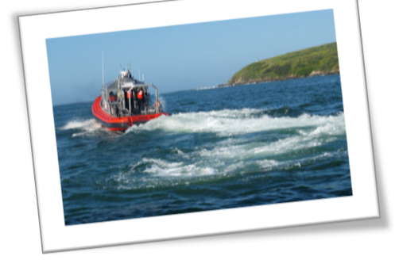

Other opportunities:
´UCD Washington DC Program: Internship
e.g. environmental group
´Marine Biology Lab at Bodega Bay (spring or summer classes)
´Credit for internships is limited to a total of 6 units that can be used towards graduation.
´Credit for tutoring is limited to a total of 3 units that can be used towards graduation.

Slide 51
CONGRATULATIONS ON YOUR ADMISSION!
WELCOME TO THE COLLEGE OF BIOLOGICAL SCIENCES!

